Slide 1
Work, Home, Self :
Keeping Balance in Your Life

Slide 2
Food for Thought
Where does your time go?
What do you feel takes too much of your time?
What is causing you stress?
What do you wish you had more time for?
Notes:
Ask the participants to consider these questions before getting into the presentation.
The goal is to have participants critically think about what brought them here today so they can participate by bringing up their questions and situations. If shared, presentation can be tailored to the audience.

Slide 3
What Causes Imbalance
Work:
Home:
Type of Duties
Lack of Training
Disagree with Management
Poor Communication
Deadline Pressures
Time Away
Parenting
Marital Strain
Money
Commitments
Self-Time

Slide 4
What Work-Life Balance is NOT
Work-life balance does not mean that there must be equal balance across all aspects of an individual’s life
The optimum work-life balance will not remain static but will vary over time.
The best work-life balance will be different for each person. There is no one size fits all in work-life balance.
Work-life balance does not negate the reality of stressors; it simply provides perspective on how to manage it all

Slide 5
Importance of Discussing This Topic
47% of people caring for elders also have childcare responsibilities (Pew Research Center, 2013)
Millennials are even more likely than their predecessors to be caring for even younger children and aging parents. (Pew Research Center, 2020)
Of married couples with children, both are employed 61.1% of the time(US Bureau of Labor Statistics , 2017)
Millennial women (born 1981-1996), like Generation X women (Born 1965-1980), are more likely to participate in the nation’s workforce than prior generations. (Pew Research Center, 2019)
Notes:
https://www.bls.gov/opub/ted/2017/employment-in-families-with-children-in-2016.htm; https://www.bls.gov/opub/mlr/2007/02/art2full.pdf;
http://www.pewsocialtrends.org/2013/01/30/the-sandwich-generation/. Sandwich generation first named by social worker Dorothy Miller in 1981, described specifically 30- or 40-something women who were caring for both children and aging parents. Now, in 2020, 40- to 50-something men and women have the main sandwich generation responsibilities. but the baton will pass again soon: The oldest millennials turn 40 next year, notes Kim Parker, director of social trends research with the Pew Research Center And because millennials have waited longer to have children than prior generations, they are even more likely than their predecessors to find themselves balancing care for even younger children and aging parents, Parker says. (Washington Post 2020)

Slide 6
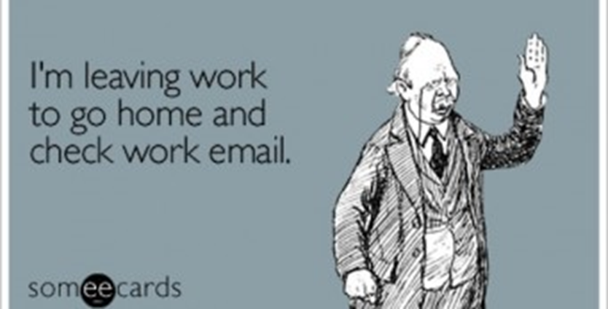

Slide 7
Definition of Stress
Occurs when faced with something that is perceived as difficult to deal with
Very individual experience
All unique individual with different life experiences, upbringings, personality types and states of health

Slide 8
Symptoms Of Stress: The Five Domains
Physical
Spiritual
Emotional
Intellectual
Social
Notes:
07/16/96
##
*
*

Slide 9
Know Your STRESS Signals
Listen to
  Your body
  Your feelings
  Your spirit
  Your relationships
  Your intellectual life

Slide 10
Symptoms Of Stress
Physical
Headaches
Muscle tension
Changes in sleep patterns
Digestive problems
Appetite changes
Reduced libido
Fatigue

Slide 11
Symptoms Of Stress
Emotional
Depression
Anxiety
Frustration
Tearfulness
Irritability/anger/rage
Mood swings
Worry

Slide 12
Symptoms Of Stress
Social
Loneliness/isolation
Irritability
Reduced social contact
Depersonalization of others
Lack of intimacy
Self-medicating behaviors

Slide 13
Symptoms Of Stress
Intellectual
Forgetfulness
Poor concentration
Distractibility
Negative attitude
Lack of awareness of surroundings
Reduced motivation/productivity
Boredom

Slide 14
Symptoms Of Stress
Spiritual
Loss of meaning
No joy in life
Apathy/cynicism
Lack of self-love and acceptance
Looking for magic
Restlessness
Reduced self-care

Slide 15
Stress-Building Thought Processes
Magnification or Minimization
Emotional Reasoning
“Should” statements
Labeling and Mislabeling
Personalization
All or nothing thinking
Over-generalization
Mental Filter
Disqualifying the Positive
Jumping to Conclusions

Slide 16
“Stuck Points” Beliefs
“Suffering from stress is a weakness.”
“Keeping stress within me is the best approach.”
“Other people or situations are to blame for my stress.”
“Cutting back or eliminating social, sporting, or personal interests will restore my balance.”
“There should be one thing I can do to have balance.”

Slide 17
The significant problems we face cannot be solved at the same level of thinking with which we created them.
(Einstein)
Notes:
07/16/96
##
*
*

Slide 18
Getting Practical
Set Limits
  Establish your priorities.
  Boundaries identify and protect.
  Give yourself a break between work and home.
  Learn and USE relaxation strategies.

Slide 19
Formula For Problem Solving
Identify Sources
Own Your Part
Realize Your Reaction
Control What You Can
Let Go of What You Can’t Control
Take Care of Yourself
Don’t Strive for Perfection

Slide 20
What are YOUR Barriers to Balance?
Time
I should…
Feeling guilty
Climbing the “ladder”
Failure to set limits
Can’t say no
Comparing

Slide 21
Limits At Work
Do what is in your power (and it may not be much) to make the workplace a friendly place.
If you have a problem at work there are, basically, three things that you can do:
  Get used to it
  Change it
  Leave it

Slide 22
Strategies to Improve Balance
Understand some things are beyond your control to change
Take action to reduce or remove the stressor
Break problems down into smaller more manageable pieces
Take a time management course
Replace negative relationships with positive ones
Adopt self – care practices
Develop outside activities – hobbies, social events, education, etc
Seek advice from others
Notes:
https://www.bls.gov/opub/ted/2017/employment-in-families-with-children-in-2016.htm; https://www.bls.gov/opub/mlr/2007/02/art2full.pdf;
http://www.pewsocialtrends.org/2013/01/30/the-sandwich-generation/. Sandwich generation first named by social worker Dorothy Miller in 1981, described specifically 30- or 40-something women who were caring for both children and aging parents. Now, in 2020, 40- to 50-something men and women have the main sandwich generation responsibilities. but the baton will pass again soon: The oldest millennials turn 40 next year, notes Kim Parker, director of social trends research with the Pew Research Center And because millennials have waited longer to have children than prior generations, they are even more likely than their predecessors to find themselves balancing care for even younger children and aging parents, Parker says. (Washington Post 2020)

Slide 23
Strategies to Improve Balance
Commit to the notion that managing stress is a permanent and ongoing activity
Learn to say no
Leave work at work
Track your time
Identify options at work and take advantage of them
Bolster your support system or ASK FOR HELP
Know when to seek professional help
Notes:
https://www.bls.gov/opub/ted/2017/employment-in-families-with-children-in-2016.htm; https://www.bls.gov/opub/mlr/2007/02/art2full.pdf;
http://www.pewsocialtrends.org/2013/01/30/the-sandwich-generation/. Sandwich generation first named by social worker Dorothy Miller in 1981, described specifically 30- or 40-something women who were caring for both children and aging parents. Now, in 2020, 40- to 50-something men and women have the main sandwich generation responsibilities. but the baton will pass again soon: The oldest millennials turn 40 next year, notes Kim Parker, director of social trends research with the Pew Research Center And because millennials have waited longer to have children than prior generations, they are even more likely than their predecessors to find themselves balancing care for even younger children and aging parents, Parker says. (Washington Post 2020)

Slide 24
Employee Assistance Program
No cost, no co-pay, not part of insurance
Easily accessed – 24/7 availability
Any issue
Legal / Financial resources
Adult and childcare resources
CONFIDENTIAL
800-624-5544
Website eap.ndbh.com
Notes:
Your EAP Benefit is free to you and all household members (family or otherwise); There is no co-pay. This is not part of your insurance benefit.
On the web site, you will find info about your specific benefits and many articles, self-assessment tools, calculators – for wellness, relationships, finances, legal issues and many more.
CONFIDENTIALITY - No one at the company will know you use this service unless you tell them. We will not tell them. Nothing is returned to the place of employment that identifies any person in any way. The company will receive a quarterly Utilization Report but it is generic numbers – not reported by department, job title, or anything that can identify you.
“How often can I use this?” If a contract is for ‘up to 6 free sessions’ that means they have up to 6 sessions per issue per year. For example, if someone comes in for relationship issues and 3 months later is experiencing grief, then can come back for up to 6 more sessions. I always say, when in doubt – call. We’ll figure it out from there.
If anyone comes up to you afterward talking about how they had a bad experience with the EAP, ask for their name and tell them we want to remedy it. The Acct. Mgr. will follow-up on this.

