Slide 1
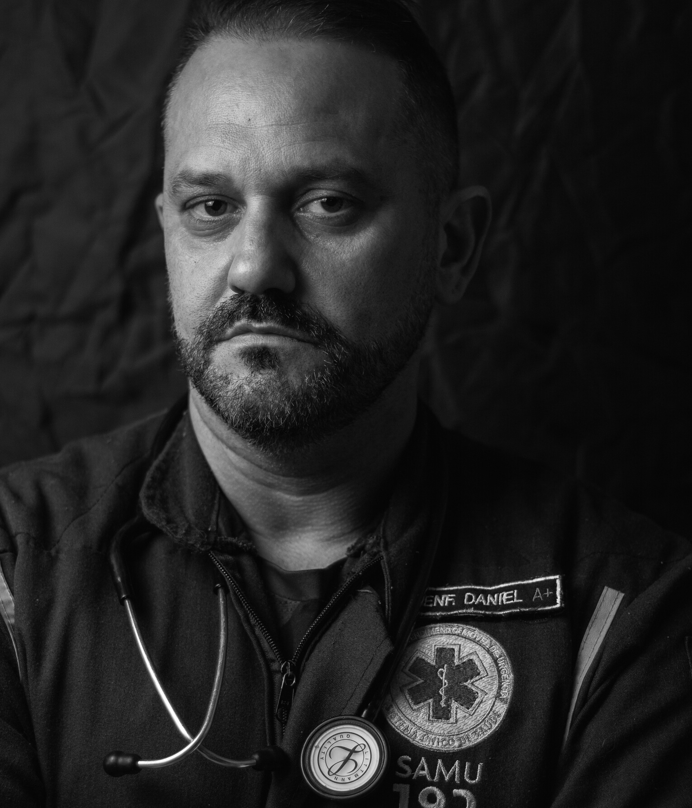

Slide 2
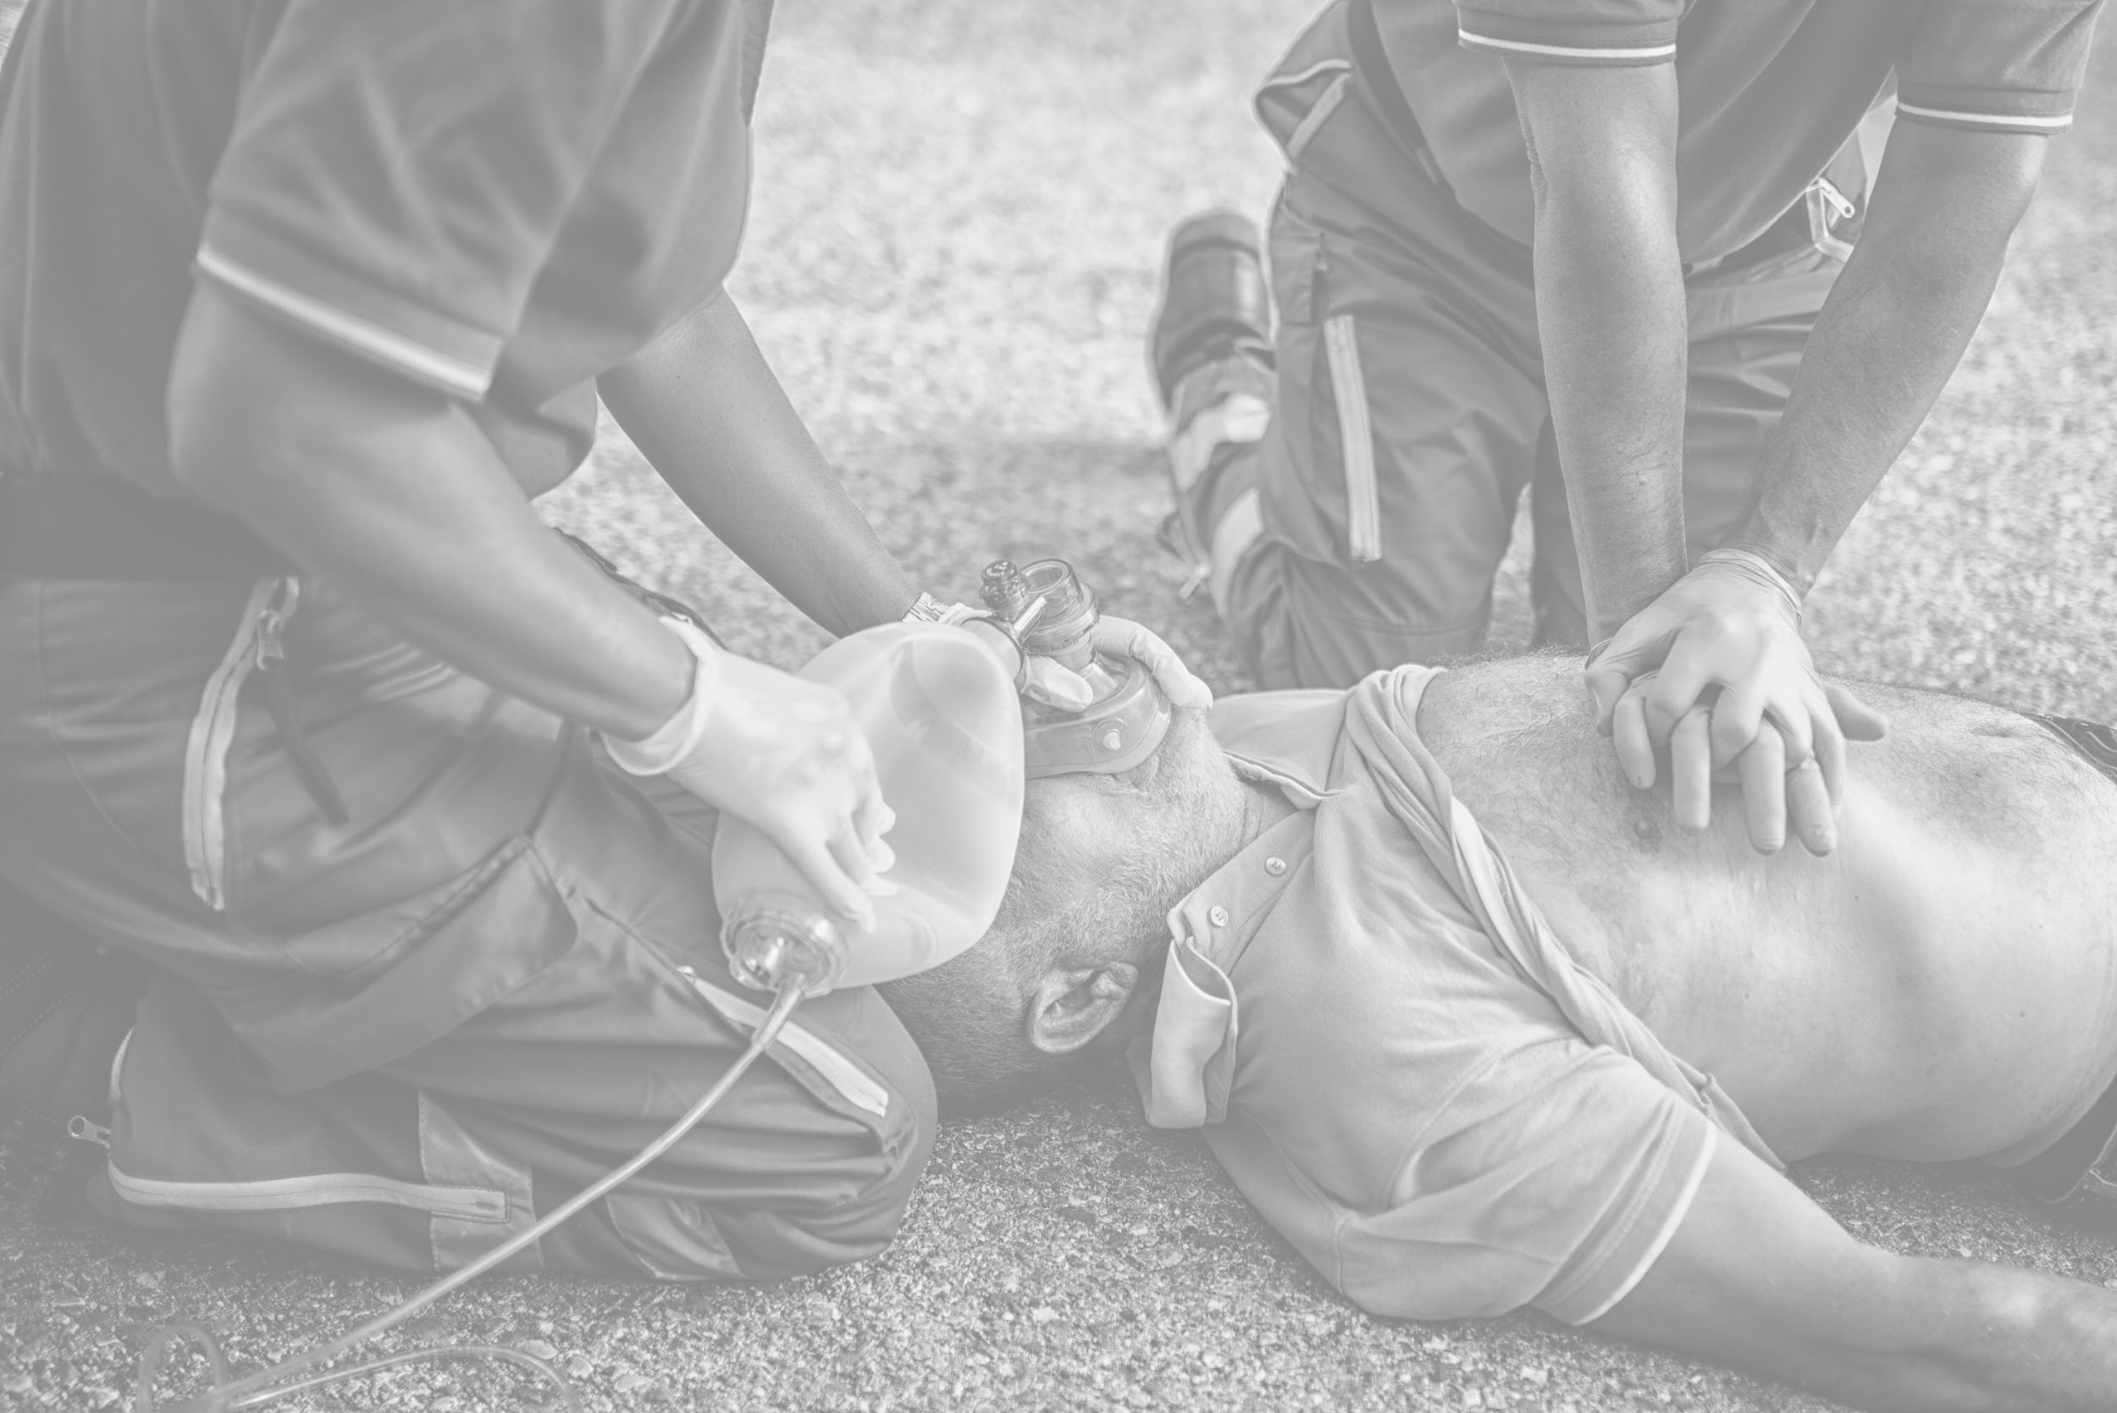
OUR MISSION
Empowering Resilience in First Responders and their Families to foster the ability to develop better Health and Mental Wellness in their Professional as well as Personal lives.

Slide 3
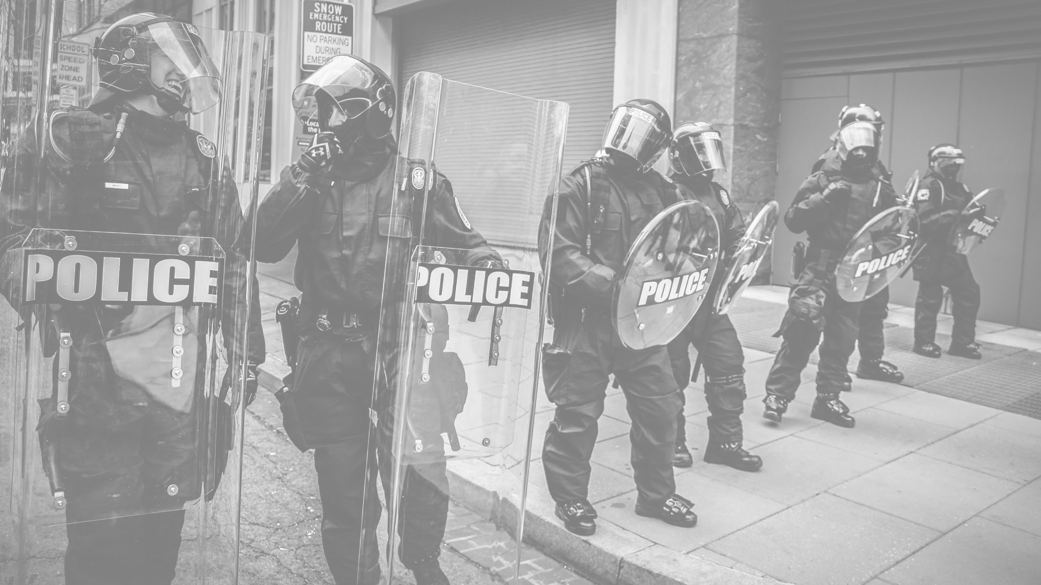
OUR WHY
HEALING THE HUMAN BEHIND THE FIRST RESPONDER IMAGE
First Responders don’t simply “get over” the Trauma they encounter throughout the course of their career. Warrior's Rest Foundation is giving them the tools to work through the Trauma, so they can thrive in spite of it.

Slide 4
WRF / ODMHSAS
Warrior’s Rest and the Oklahoma Department of Mental Health and Substance Abuse Services (ODMHSAS) are working together to provide Peer Support Crisis Intervention, Counseling and Wellness for First Responder communities impacted by Trauma, Stress, Anxiety, Addictions, Death and Suicide. Our focus is on areas of Wellness such as Physical, Mental, Relational, Spiritual, Financial and Emotional Health of First Responders since they impact job performance.
Notes:
Senate Bill 848

Slide 5
Training
Warrior’s Rest provides programs to support First Responders and their Families who have experienced significant Trauma due to job-related incidents. Our resources are led by First Responders and “Culturally Competent” Clinicians, who have firsthand experience applying Crisis Intervention techniques to exceptionally difficult incidents. Our program foundations include Crisis Intervention, Wellness Education, Counseling, and Peer Support.
ICISF / CISM
Post Critical Incident Seminar (PCIS)
Continuing Education
Critical Incident Stress Management (CISM) is taught to participants to provide knowledge and tools to use in different types of Group and Individual crisis interventions, including Crisis Management Briefings, Defusing and Critical Incident Stress Debriefing.
Peer Team
(Development and Sustainability)
Resiliency
Addiction
Marriage/Family
Finance
Strength and Conditioning / Nutrition
Warrior’s Rest provides intervention, education, counseling and peer support in a structured, intensive 3-day seminar environment. This is offered to all current or retired First Responders and their Spouses or Significant Others.
.

Slide 6
FIRST RESPONDERS
AGENCY LEADERS
You are NOT alone. There is hope to heal the Trauma you endure on the job.
The cumulative weight of the traumatic sights, sounds, smells, and memories affect work performance, career longevity, and relationships, however, it is NOT a “life sentence”. Warrior’s Rest provides the training, tools, and teams to empower First Responders to build resilience in the face of high-impact Trauma.
Care for your people and increase retention by building healthy personnel.
Due to stigma, embarrassment or fear of repercussions, many First Responders won’t seek professional help for their mental health. Warrior’s Rest is working to change the narrative while providing comprehensive training and peer support groups so your people can be equipped for a healthy, successful career and Family life.

Slide 7
COPING MECHANISMS
FAMILIES
Healthy First Responders have
Stronger, Longer Careers.
Trauma is part of the job, but it’s not always part of the job training. First Responders need specialized training and resources to know how to address, process, and cope with Job-Related Trauma. Warrior’s Rest empowers Resilience in First Responders through training, teams, and tools so they can heal from the trauma they encounter and sustain successful careers.
Helping our Heroes Heal from Traumatic Events.
First Responders experience many significant traumatic events throughout their careers. Most First Responder training focuses on how to be Physically Strong, but many are not given the tools to thrive Mentally or Emotionally. The brave men and women that keep our family safe need our support so they can build Healthy Families and Lasting Careers.

Slide 8
WARRIOR'S REST FOUNDATION
HELPING FIRST RESPONDERS
TO HEAL FROM
FRONTLINE TRAUMAS
Warrior's Rest is building healthy and resilient frontline warriors
by creating infrastructures that prioritize emotional health and
physical wellness to protect career longevity.

Slide 9
HEALING BEGINS IN
COURAGEOUS CONVERSATIONS

Slide 10
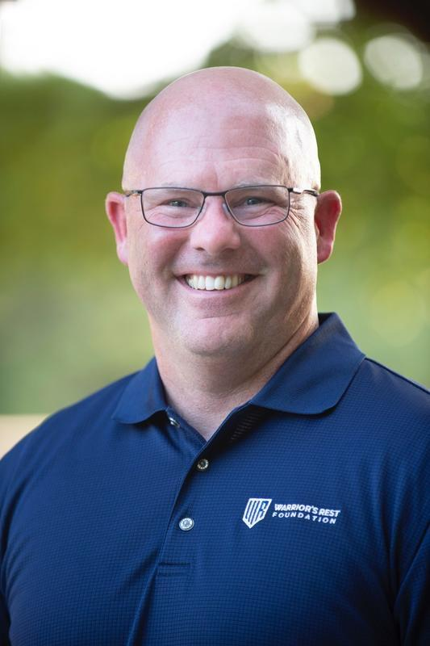
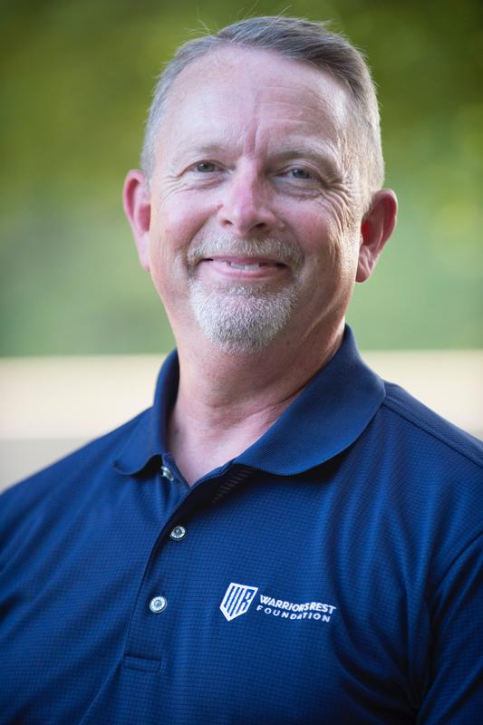
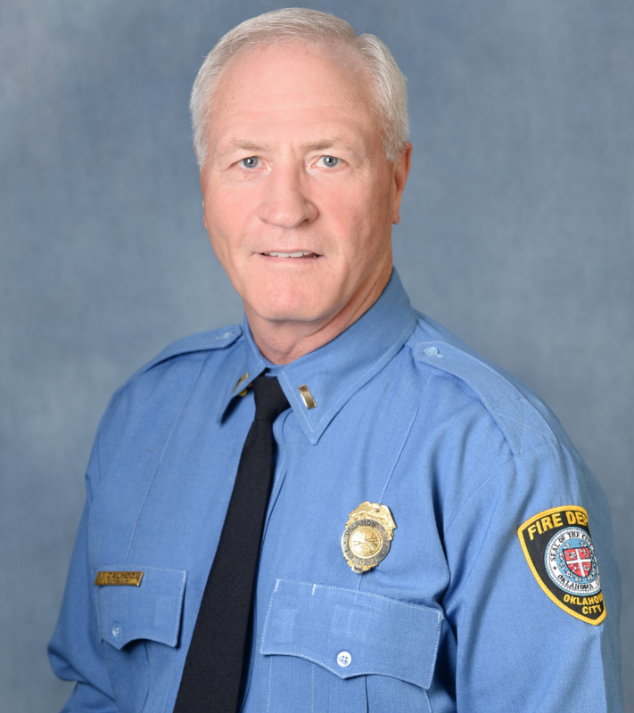
WE ARE YOU
BRETT KEY
EXECUTIVE DIRECTOR
GARY BERRYHILL
DIRECTOR of OPERATIONS
MARK CALHOON
FIRE/EMS LIAISON
HELPING FIRST RESPONDERS HEAL FROM FRONTLINE TRAUMAS

Slide 11
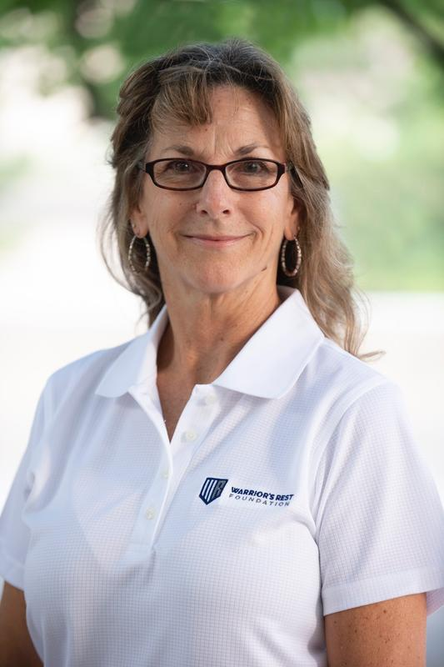
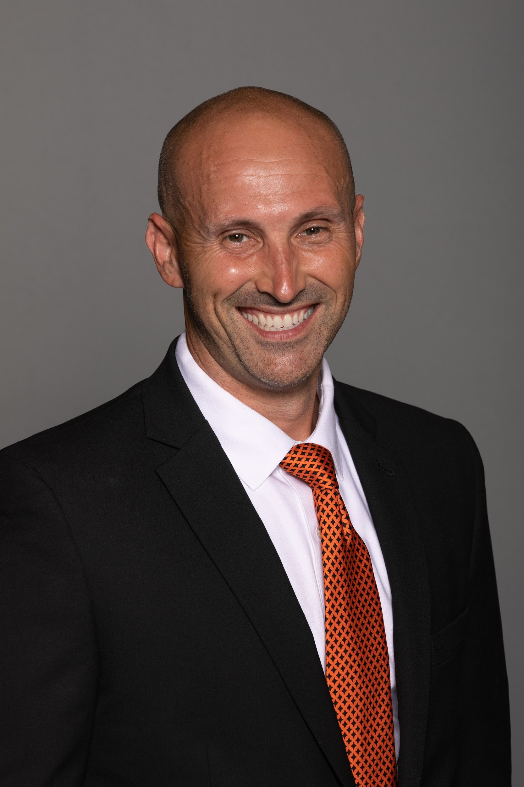
WE ARE YOU
Dr. KATHY THOMAS, PhD
CLINICAL DIRECTOR
JILL NEWMAN, LPC-S
DIRECTOR of EDUCATION and OUTREACH
Dr. JAY DAWES, PhD
DIRECTOR of WELLNESS and PHYSICAL FITNESS
HELPING FIRST RESPONDERS HEAL FROM FRONTLINE TRAUMAS

Slide 12
Office # 405-285-0544
www.warriorsrestfoundation.org
info@warriorsrestfoundation.org

Slide 13
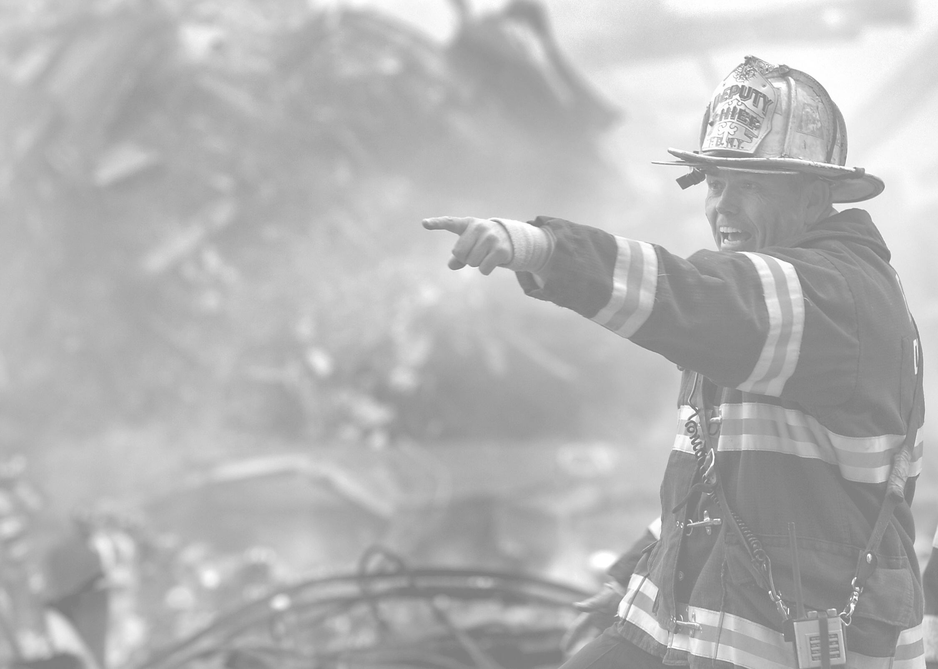
Leaders
Care for your people and increase retention by building healthy teams.
The compounding pressure on your people and teams is unhealthy and unsustainable, and the results can be dangerous. First Responders are taught to be tough, but this can cause systemic issues without the proper systems to process the trauma they encounter on the job. Warrior’s Rest provides comprehensive training and peer support groups so your people can be equipped for a healthy, lifelong career.

Slide 14
TAGLINE
WARRIOR'S REST FOUNDATION
RESTORING THE WARRIOR WITHIN

Slide 15
Training
Warrior’s Rest provides programs to support First Responders, their partners, and families who have experienced significant traumas due to job-related incidents. Our resources are led by First Responders and First Responder Clinicians, who have firsthand experience applying crisis intervention techniques in exceptionally difficult environments. Our program foundations include crisis intervention, education, counseling, and peer support.
ICISF/CISM
Post Critical Incident Seminar(PCIS)
Continuing Education
Fundamentals of Critical Incident Stress Management (CISM) are outlined and participants are taught the knowledge and tools to provide several group and individual crisis interventions, specific demobilizations, defusings and Critical Incident Stress Debriefing (CISD)
Warrior’s Rest peers and clinicians provides intervention, education, counseling and peer support in a structured, intensive 3-day seminar environment. This service is offered to all First Responders and their spouses or significant others.
.
Peer Team development and sustainability
Resiliency
Addiction
Marriage/Family
Finance
Strength and Conditioning/Nutrition

Slide 16
WELLNESS and CISM/PEER Trainings
2021 (Sept 2021 – Dec 2021)
198 Total 1st Resp’s Rec’d Wellness or CISM Information / Training in 2021
2022 (Jan 2022 – Dec 2022)
24 Wellness Presentations & Trainings at Various Agencies & Conferences in OK.
945 First Resp’s or MHP’s trained from Multiple Agencies in Oklahoma.
19 CISM / Peer Trainings at Multiple Locations in OK.
322 1st Resp’s or MHP’s trained from 89 various Agencies in Oklahoma.
1,267 Total 1st Resp’s Rec’d Wellness or CISM Information / Training
NOTE: These numbers do Not reflect the numerous Peer Support Responses, Contacts, or other Peer Services provided by WR.

Slide 17
OUR MISSION
Empowering resilience in First Responders, their partners, and families
to foster healthy personal and professional lives.

Slide 18
Leaders
Care for your people and increase retention by building healthy personnel.
The cumulative pressure on your people is often unhealthy and unsustainable with results which can be dangerous. First Responders are taught to be tough, but this can cause systemic organizational issues without the proper knowledge & resources to process the Trauma they encounter on the job. Warrior’s Rest provides comprehensive training and peer support groups so your people can be equipped for a healthy, lifelong career.

