Slide 1
First Responder
Mental Wellness

Slide 2
Introduction
Director Darry Stacy
darry.stacy@cleet.state.ok.us
405-239-5150

Slide 3
Objectives
Be Aware
Be aware of mental health issues, stressors, and the importance of seeking help.
Understand
Understand the challenge and reduce the stigma associated with seeking mental health support.
Learn
Learn to build resilience in coping with stress and managing emotional responses to challenging situations.
Understand
Understand signs of mental health issues in themselves and their colleagues and provide guidance.
Learn
Learn to encourage open communication to provide necessary tools and support to promote well-being and resilience in the face-to-face unique challenges.

Slide 4
Why is Mental Wellness for First Responders essential?
First Responders often work in a high-stress and dangerous situations!
This Photo by Unknown Author is licensed under CC BY-SA

Slide 5
First Responders encounter unique stressors…
Accidents resulting in death
Fellow worker
Family member
Children
Crime
Child abuse
Pursuits
Human Trafficking
Suicide by cop
Violence
Physical assaults
Armed confrontations
Disasters
Mass shootings
Bombings
Natural disasters

Slide 6
First Responders are Human Beings…
Mental Health issues can have a high impact on …
Strained relationships
Sexual addictions
Alcohol or drug dependency
Embezzlement
Suicide
This photo courtesy of : The Hollywood Reporter

Slide 7
Consequences of Ignoring Mental Wellness
They will isolate themselves leading to feelings of loneliness and disconnect from their family and friends.
Emotional distress can lead to anxiety, depression and post-traumatic stress disorder (PTSD).
Difficulty expressing emotions which can be a challenge to open up and seek help.

Slide 8
Consequences of Ignoring Mental Wellness (Continued)
Self-coping mechanism is a temporary fix from stress trauma.
Can turn to prostitution and alcohol or drug abuse.
Reduce in job performance.
Increased risk taking on the job.
Higher burnout rates.

Slide 9
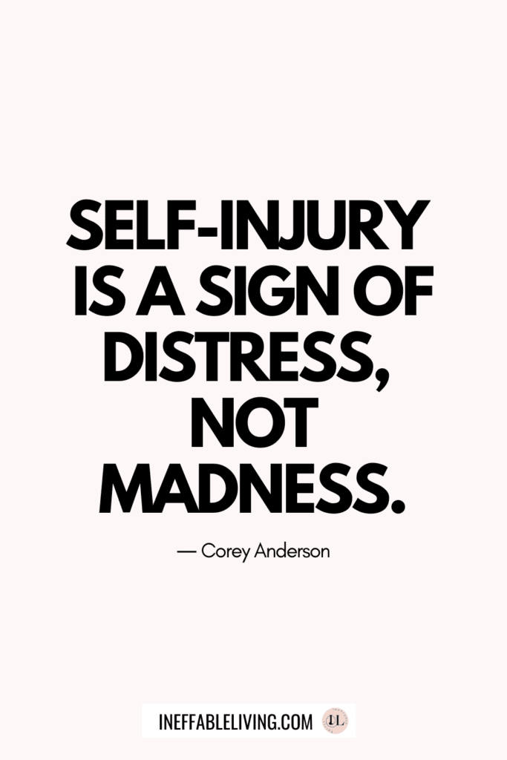
Consequences of Ignoring Mental Wellness (Continued)
Legal and ethical issues due to errors in judgement or behavior resulting in lawsuits or criminal charges.
Increased risk of self-harm and suicide.

Slide 10
Strategies to Promote Mental Wellness
To provide comprehensive mental health education and training to administration as well as first responders.
To release the stigma surrounding mental health within first responder’s agencies. It is no longer perceived as a sign of weakness but a support and coping mechanism they need.
It is a peer support program. They learn to share their experiences and provide guidance to others.
Provides a healthy balance for a healthy work-life. Ensuring adequate time off and discouraging excessive overtime.
Provide continual assessment and improvement to work-life and home life.

Slide 11
First Responder Mental Wellness in the CLEET Academy
Early intervention- Equip the newest first responders with the necessary tools and knowledge from the start of their careers.

Slide 12
First Responder Mental Wellness in the CLEET Academy
Cultural Change- Integrating mental wellness into the academy curriculum can help shift the culture within the agencies.
Reduce the stigma associated with seeking help.

Slide 13
First Responder Mental Wellness in the CLEET Academy
Comprehensive Training- Teach them to recognize signs of stress and mental issues.
Help them cope with understanding the impact of trauma.
Teach them coping mechanisms and strategies.

Slide 14
First Responder Mental Wellness in the CLEET Academy
The outcome will be GREAT!
Proactively address the mental health needs.
Promote a healthier organization
Promote positive outcomes for first responders, agency, and community.

Slide 15
Contact Information
Director Darry Stacy
darry.stacy@cleet.state.ok.us
405-239-5150
Please scan the QR code and complete the electronic form for 1 hour of CLEET Training

