Slide 1
Wes Martin, MAIOP, ACC
Co-Founder of Grovity Leadership
Executive Coach & Keynote Speaker

Slide 2
“He who has a why to live can bear almost any how.”
-Friedrich Nietzsche

Slide 3
KNOW YOUR WHY
How knowing and
living your why can
change everything

Slide 4
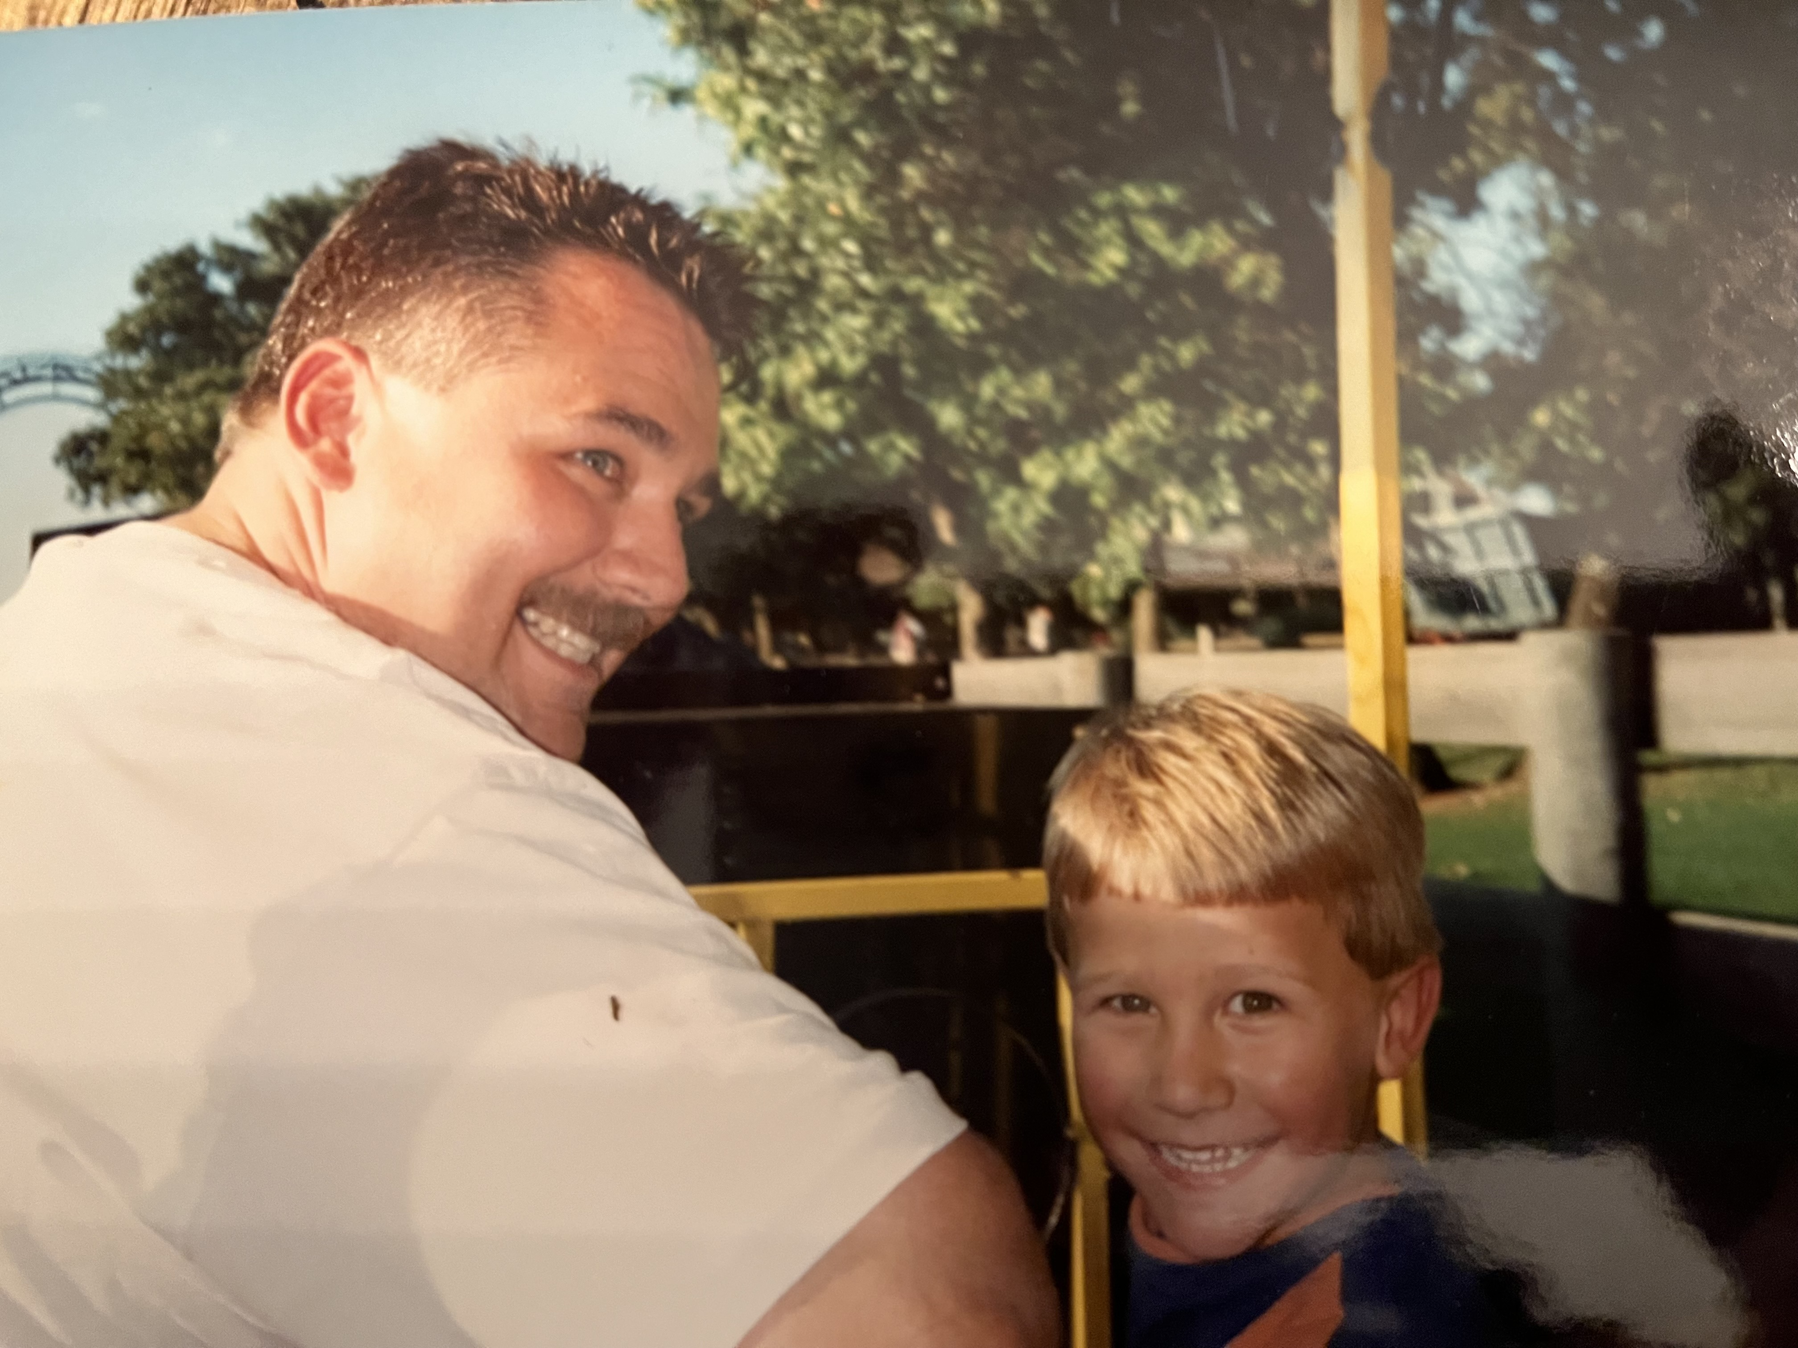

Slide 5
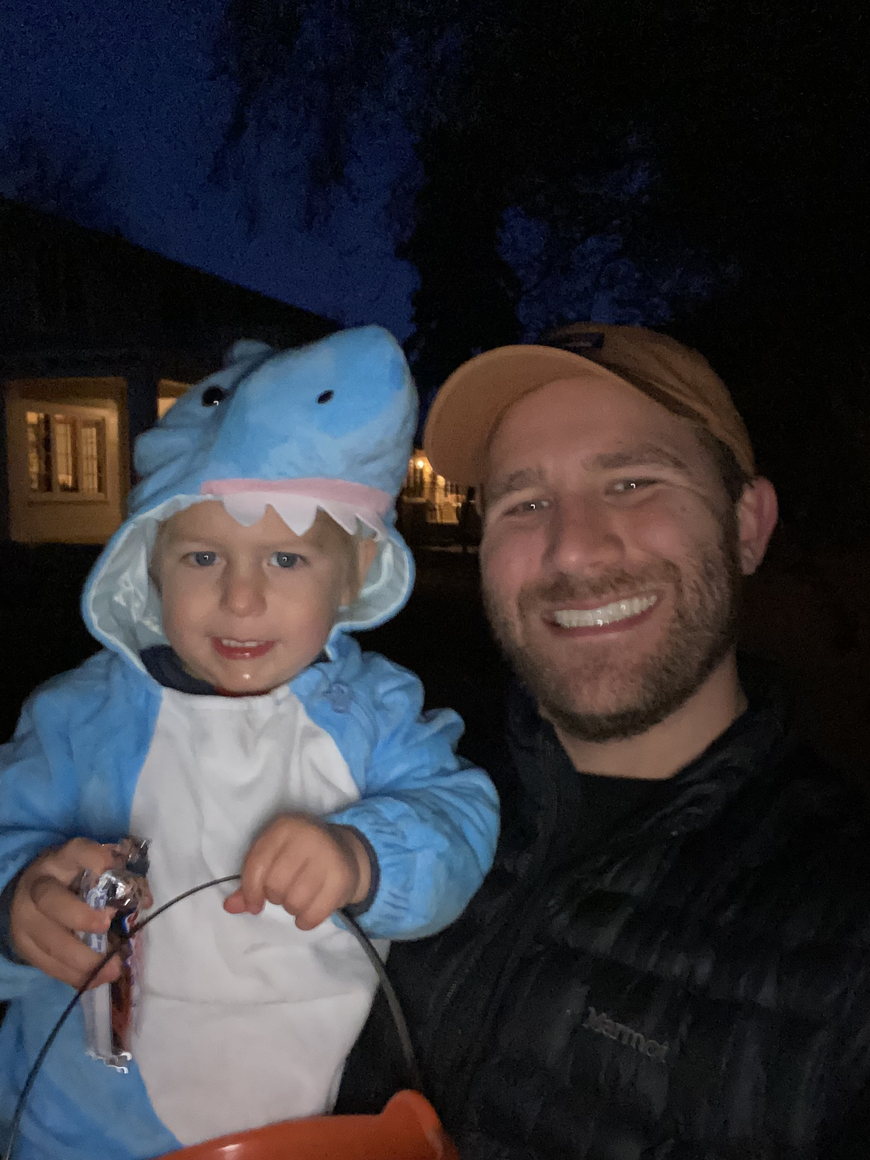
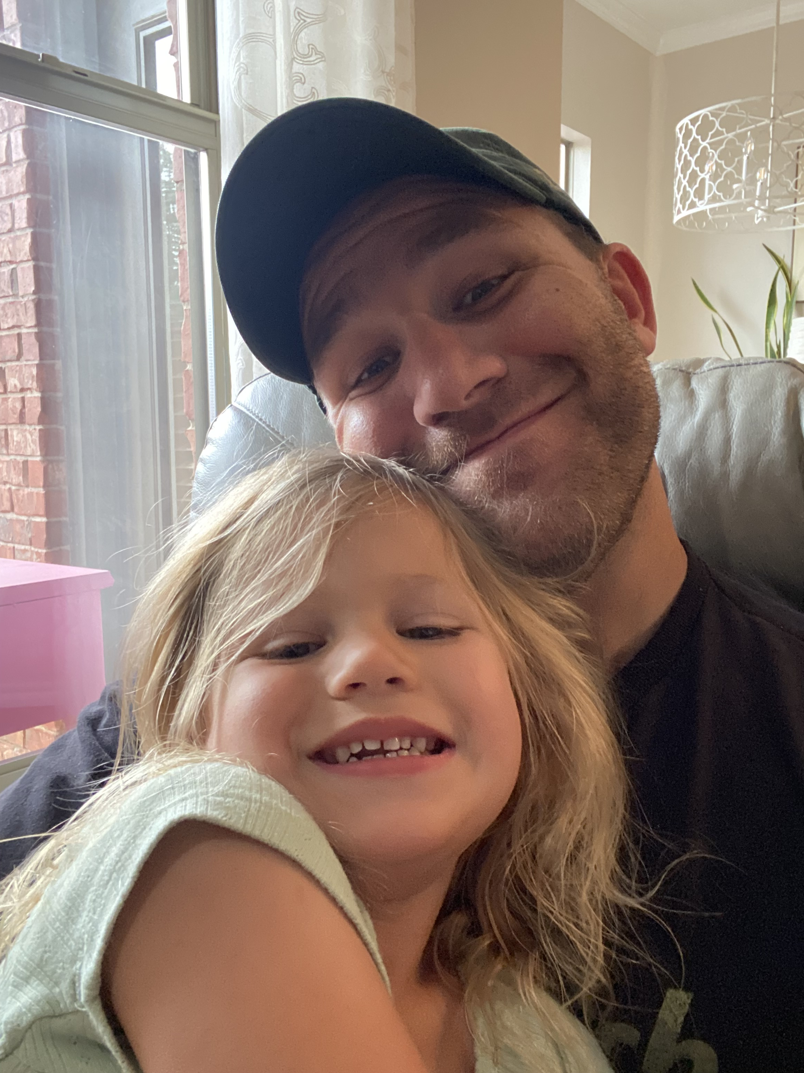

Slide 6
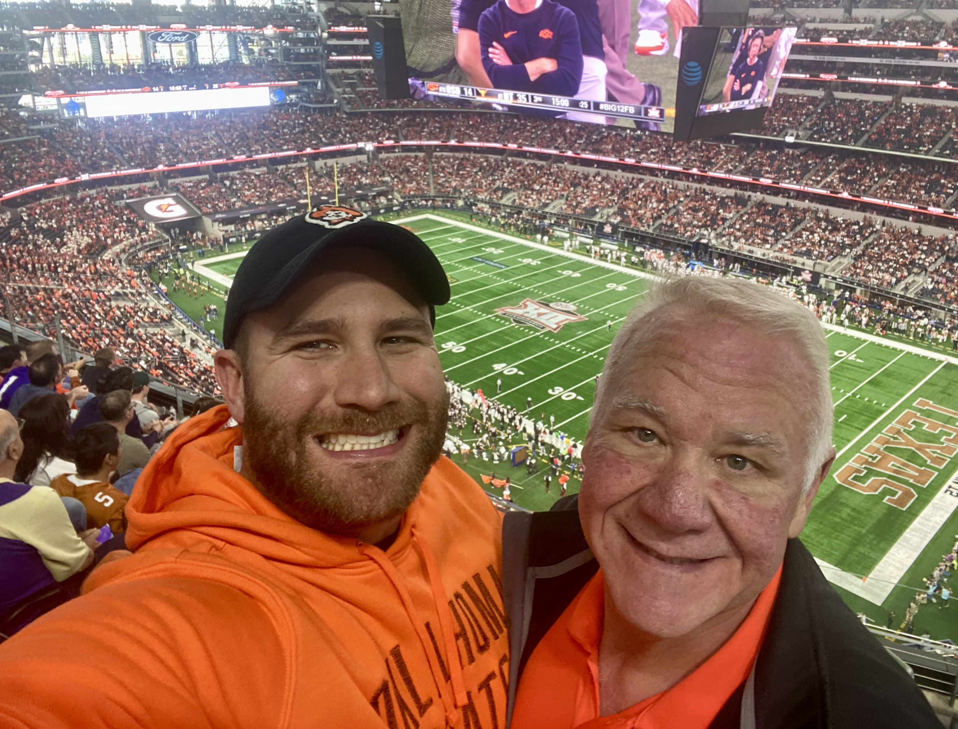

Slide 7
WHY TRUTH #1
YOUR WHY
IS INNATE,
INHERENT, AND
INSEPARABLE.

Slide 8
Your why is not “out there” waiting to be found.
Your why is “in here” waiting to be engaged.

Slide 10
“Listen to your life. See it for the fathomless mystery that it is. In the boredom and pain of it no less than in the excitement and gladness.”
-Frederick Buechner

Slide 11
WHY TRUTH #2
YOUR WHY
IS OFTEN
ROOTED IN PAIN AND
MANIFEST IN COMMUNITY.

Slide 12
“What is most personal
is most universal.”
-Carl Rogers

Slide 13
Notes:
“Ben’s” story

Slide 14
YOUR WHY
YOUR DEEP GLADNESS
THE WORLD’S DEEP NEED
Source: Adapted from “Listening to Your Life”, Buechner, Frederick.

Slide 15
WHY TRUTH #3
YOUR WHY
SITS IN THE
SPACE BETWEEN
WHAT IS, AND
WHAT COULD BE.

Slide 16
What is obvious to you is often non-obvious to others.
What is natural to you is often unnatural to others.

Slide 17
EMPATHIZE
IDEATE
DEFINE
PROTOTYPE
TEST

Slide 18
“If you can't fly, then run. If you can't run, then walk. If you can't walk, then crawl, but whatever you do, you have to keep moving.”
-Martin Luther King Jr.

Slide 19
INSIGHT + ACTION
= TRANSFORMATION

Slide 20
“Life’s beauty is inseparable from
its fragility.”
-Susan David

Slide 22
“Ultimately, man should not ask what the meaning of his life is, but rather he must recognize that it is he who is asked.”
-Viktor Frankl

