Slide 1
Hiring, Retention, and Engagement

Slide 2
Great Leaders……………….
Build Relationships
Develop People
Lead Change
Inspire Others
Think Critically
Communicate Clearly
Create Accountability
(Gallup, 2023)
Notes:
Most of these actions cost nothing, but doing nothing costs you everything!

Slide 3
Culture Impacts Hiring and Retention
“For us, we define culture as the collective personality of our organization. It’s who we are, but more importantly, it’s who we aspire to be. Every organization has a personality.” LinkedIn CEO Ryan Roslansky
Notes:
If I were to ask your employees about your culture, what would they say?

Slide 4
Hiring
The hiring process begins well before the job opens
What seeds are you planting for your organization?
What connections do you have with your local educational institutions?
Who is championing your story?
Culture, Culture, Culture

Slide 5
Hiring
How long is your hiring process?
The average time-to-hire includes multiple interviews and lasts around 43 days in the private sector. (Harvard Business Review, 2022)
Local Government more than doubles this, averaging over 90 days (ICMA, 2022)
62% of working professionals say they lose interest two weeks after an initial interview if they haven’t heard back. (Harvard Business Review, 2022)
Bureaucratic Hiring Processes
Unappealing job announcements
Insistence on Minimum Qualifications

Slide 6
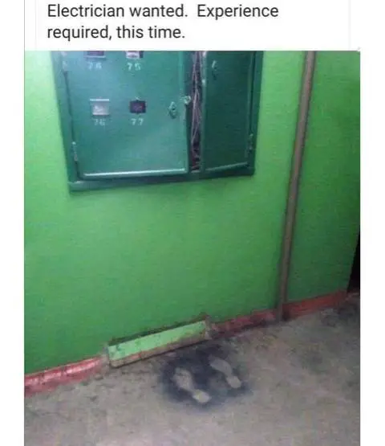
Hiring
Reengineer hiring and recruitment processes
Eliminate timely steps in the process
Eliminate Minimal Qualifications
Move from pedigree to potential
Enhance Job Announcements
Move from boring and unexciting
Trumpet the Why! Opportunity to make a difference.

Slide 7
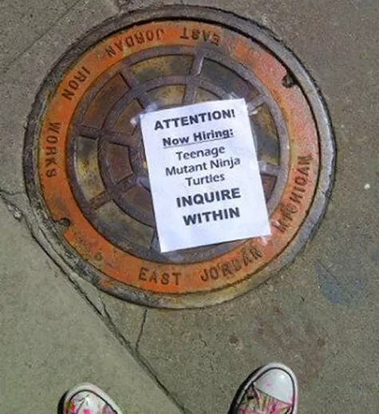
Hiring
Job Titles
Director of bean counting (finance)
Jack of All Trades/Master of None (Public Works)
Rapid Water Transportation Specialist (Line Maintenance)
Outdoor Enthusiast (Meter Reader)
Director of First Impressions (Front Desk)

Slide 8
Hiring
Job Title: Circus Ring Leader/Animal Control Officer
Do you have a passion for animals, a sense of adventure, and a desire to save the day? Look no further! We have an exciting opportunity for you to become an Animal Control Officer for our Sunnyville, OK. But beware, this job is not for the faint of heart!
As an Animal Control Officer, your main responsibility will be ensuring the safety and well-being of our furry friends. You will be the hero who saves the day when an escaped parrot interrupts an important city council meeting or when a mischievous raccoon disrupts a peaceful neighborhood BBQ.
But wait, it doesn't stop there. You will also be tasked with apprehending runaway chickens, capturing snakes that have found their way into someone's bathtub (yes, it happens more often than you think!), and rescuing stranded kittens from tree branches. You'll need your wits about you and a hefty dose of courage for these daring feats!
In addition to being an animal lover, you must possess excellent problem-solving skills. Picture this: a llama is blocking an entire street, causing a traffic jam. You must use your quick thinking to wrangle the llama into a nearby park without causing any harm to the animal or the passing cars. It's a balancing act, quite literally!

Slide 9
Hiring
Don't forget that this job requires you to be a master negotiator. You'll be dealing with all sorts of characters, from hysterical pet owners to snappy turtles. You must calm their fears, gain their trust, and convince them to cooperate with your animal control strategies.
Finally, as an Animal Control Officer, you'll be part of a dynamic team. You'll work closely with local veterinarians, animal shelters, and even the police department. This collaborative effort ensures that every animal receives the care and attention they deserve.
So, if you're looking for a job that combines adventure, problem-solving, and furry friendships, then become our next Animal Control Officer. Get ready to don your superhero cape and join us in making our city a safer place for all creatures great and small. The animals are counting on you!

Slide 10
Retention/Engagement
The majority of the U.S. workforce (65%) is not engaged, according to Gallup's State of the Global Workplace: 2022 Report. These employees are indifferent and neither like nor dislike their job. They represent a risk that can tilt either way -- good or bad. Gallup: State of the Global Workplace: 2022 Report

Slide 11
Engaging Local Government Employees
Meaningful Work: The connections people make to a larger purpose in their jobs. Local government offers meaningful work in spades, from the manager’s office to the utility billing specialist to the building inspector. Emphasizing work meaning to employees is a low-cost, easy thing to do. It’s as simple as talking constantly about organizational mission, in Mission Minutes at meetings, in supervisory training, and in mission and values posters plastered all over your local government campus.
Trust in the Workplace: Generally, employees trust their supervisors more than they trust upper management, which makes sense given that employees see and hear from their supervisors regularly. More trust correlates with higher engagement scores and is built by discouraging micromanagement, communicating regularly, and consistently applying policies and messages.
Openness to New Ideas: Nothing sucks the lifeblood out of morale like resistance to change. From Millennials to Boomers, employees generally like workplaces where things are happening: improvements are continual, learning is constant, and growth is the norm rather than the exception. Open your workplace to new ideas by ALWAYS seeking employee input for significant changes, rewarding employee brainstorms (food is a great motivator), and never saying “No” right off the bat to new ideas.
International City/County Management Association

Slide 12
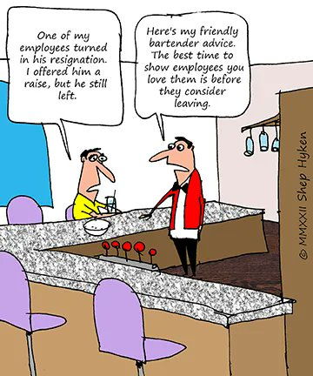
Retention/Engagement
Employees Desire An Enhanced Employee Experience
A sense of purpose and meaning
Autonomy (independence or freedom, as of the will or one's actions)
Learning and Growth
Belonging and Community
Culture of Gratitude
Focus on creating a connection

Slide 13
Retention/Engagement
A sense of purpose and meaning
Constantly talk about the “why” of our work
Help employees perceive meaning by asking in one-on-one conversations and team meetings, “Why is this project important to you?”
Autonomy
Autonomy is a great self-motivator, allowing the employee control and supporting their process
Ask why their efforts are important, what success looks like to them, and how I can support you.

Slide 14
Retention/Engagement
Learning and Growing
Commit to learning and career development as key organizational values
Teach managers how to conduct developmental conversations
Inquire about your employee’s hopes and dreams, options to achieve these hopes, obstacles to overcome, and support needed)
Provide a menu of developmental activities (OMAG, OML, Technical Centers)
Develop career ladders (structured opportunities to grow and advance within the organization)
"Anyone who stops learning is old — whether this happens at twenty or at eighty. Anyone who keeps on learning not only remains young but becomes constantly more valuable — regardless of physical capacity." ~ Henry Ford

Slide 15
Retention/Engagement
Belonging and Community
Focus on creating a connection
The Gallup Organization indicated that a key to actively engaged employees is that “At work, someone cares about me.”
Taking 5 minutes at the beginning of meetings to talk about non-work interests
Research indicates that high-performing teams spend 25% more time on non-work topics than lesser-performing teams
Food, food, food: The more often people eat with their colleagues, the more likely they are to feel connected (Oxford University).

Slide 16
Retention/Engagement
Culture of Gratitude
Demonstrate Appreciation
Gallup identifies recognition as another key driver for employee engagement
Begin meetings with shout-outs, recognizing accomplishments
Write a personal thank you note to a staff member, recognizing them for their efforts
Focus on Creating a Connection
Walk about, checking in with employees throughout the City.
Stay Interviews: Learn what will keep the employee working for the organization. This is a powerful way to connect and re-recruit employees.

Slide 17
Building Culture in Mustang, OK
Hand Written Thank You Notes
Unique Works Hours: Monday – Thursday 7:30 to 5:30, Friday 7:30 to 11:30
Family First
Dress for the Day: No dress code; wear what you think is appropriate for the day
Honor downtime: Employees are encouraged to stay off emails after hours, and management is encouraged to avoid reaching out to employees when they are off the clock
Management: Spend time with every employee (Create Connections)
Monthly Birthday Pot Luck Lunch

Slide 18
Hiring/Retention/Engagement
The Nuggets!
Culture – the key to hiring/retention/engagement
The hiring process begins before the job is open; plant the seeds!
Evaluate your hiring process!
Our work is meaningful; tell the story!
Provide an enhanced employee experience!

Slide 19
Hiring/Retention/Engagement
“I've learned that people will forget what you said, people will forget what you did, but people will never forget how you made them feel.”
Maya Angelou
“It’s not the people you fire who make your life miserable. It’s the people you don’t.” Dick Grote

Slide 20
Hiring/Retention/Engagement
Questions/Comments?
Be the Change You Want to See!

