Slide 1
TOP HITS IN EMPLOYMENT LAW LEGAL DO’S AND DON’TS
BETH ANNE CHILDS
THE CHILDS LAW FIRM, PLLC
1015 DETROIT AVENE
TULSA, OKLAHOMA 74120

Slide 2
MUNICIPAL EMPLOYMENT LAW IS A “CRAZY TRAIN”

Slide 3
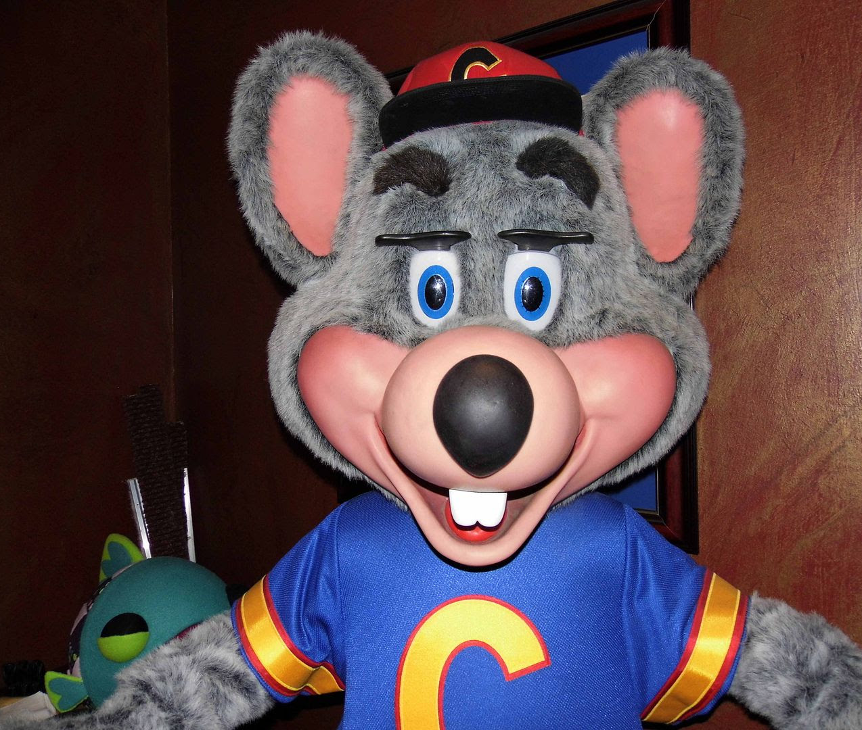
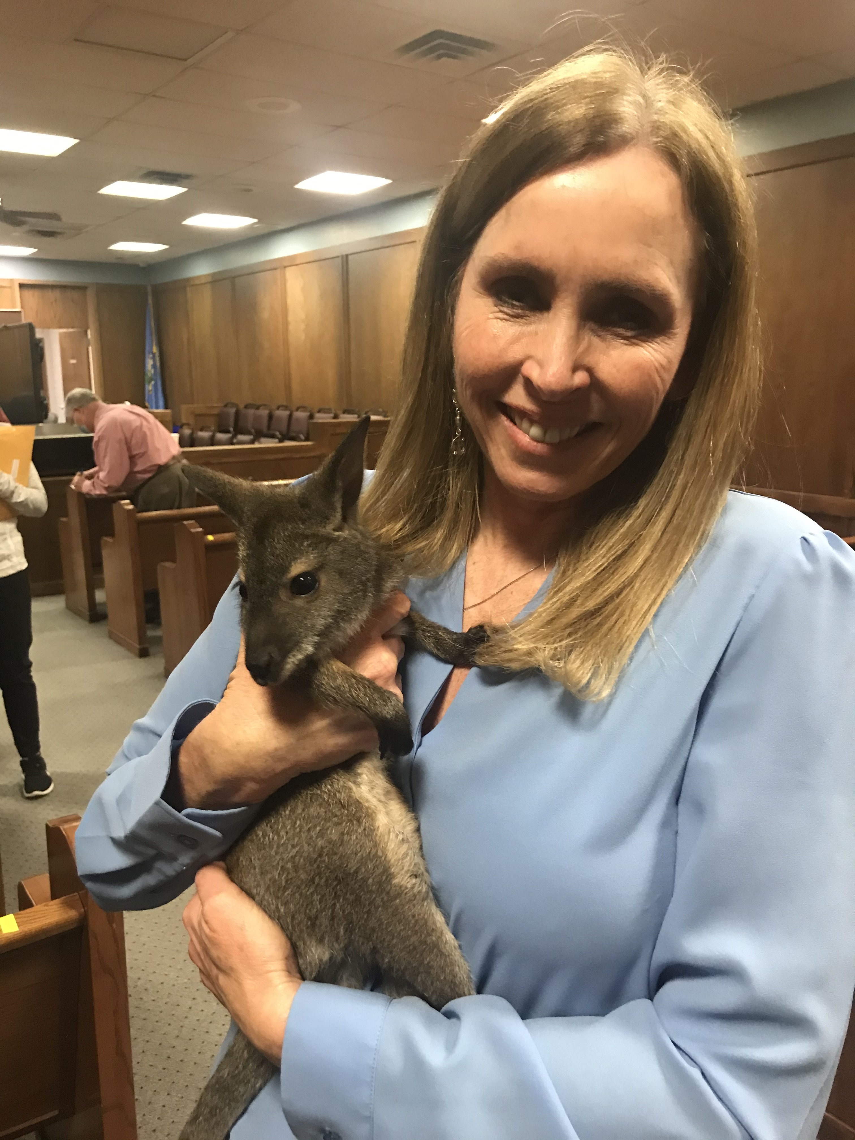

Slide 4
EMPLOYMENT SUITS ARE ALL ABOUT THE “MONEY, MONEY, MONEY”
EMPLOYMENT SUITS ARE EXPENSIVE!
MAKE SURE YOU HAVE GOOD POLICIES!
TRAIN YOUR EMPLOYEES AND SUPERVISORS!
ENFORCE YOUR POLICIES AND PROCEDURES!
FOLLOW THE DEGREES OF WORK!
USE YOUR H.R. PERSONNEL AND ATTORNEYS!
This Photo by Unknown Author is licensed under CC BY-NC-ND

Slide 5
WORKING MORE THAN “9 TO 5” CAN BE A VIOLATION OF THE FLSA

Slide 6
THE FAIR LABOR STANDARDS ACT (FLSA) – WORKING “HARD FOR THE MONEY”
Requires employers to pay covered employees who are not otherwise exempt at least the federal minimum wage and overtime pay of one-and-one-half times the regular rate of pay.
Restricts the hours that children under age 16 can work, forbids the employment of children under the age of 18 for certain dangerous jobs. There are certain exemptions for agricultural operations.

Slide 7
FLSA DO’S
HAVE EMPLOYEES USE TIME SHEETS
ENSURE TIMESHEETS ARE CORRECT
MANAGE EXPECTATIONS

Slide 8
FLSA DON’TS
EXPECT EMPLOYEES TO “VOLUNTEER”
REFUSE TO PAY OVERTIME
GET CREATIVE IN AN ATTEMPT TO AVOID OVERTIME

Slide 9
VIOLATION OF USERRA CAN TAKE YOUR “ANCHORS AWAY”

Slide 10
UNIFORMED SERVICES EMPLOYMENT AND REEMPLOYMENT RIGHTS ACT (USERRA)
Certain persons who serve in the armed forces have a right to reemployment with the employer they were with when they entered their service. This includes those called up from the reserves or the National Guard.
There are detailed provisions regarding promotions, pay, reemployment, and leave in both state and federal laws that need to be carefully followed.

Slide 11
USERRA DO’S AND DON’TS
DO’S
BE FAMILIAR WITH THE BASIC PROVISIONS OF USERRA
CONSULT YOUR H.R. PROFESSIONAL AND CITY OR TOWN ATTORNEY
DON’TS
DISCOURAGE PARTICIPATION IN THE MILITARY
MAKE UNSOLICITED COMMENTS ABOUT MILITARY SERVICE AND THEIR EMPLOYMENT

Slide 12
WHEN YOU NEED A “DOCTOR DOCTOR” MAKE SURE YOU FOLLOW THE FMLA

Slide 13
THE FAMILY AND MEDICAL LEAVE ACT (FMLA)
THE FMLA REQUIRES EMPLOYERS OF 50 OR MORE EMPLOYEES TO GIVE UP TO 12 WEEKS OF UNPAID, JOB-PROTECTED LEAVE TO ELIGIBLE EMPLOYEES FOR THE BIRTH OR ADOPTION OF A CHILD OR FOR THE SERIOUS ILLNESS OF THE EMPLOYEE OR A SPOUSE, CHILD OR PARENT

Slide 14
FMLA – MAKE SURE YOU TRACK LEAVE “TIME AFTER TIME” - DO’S AND DON’TS
DO HAVE AN UPDATED FMLA POLICY
DON’T FAIL TO FOLLOW THE POLICY
DO REQUIRE MEDICAL DOCUMENTATION
DON’T FAIL TO ENGAGE IN DISCUSSIONS WITH THE EMPLOYEE
DO EDUCATE YOUR EMPLOYEES ABOUT THE POLICY

Slide 15
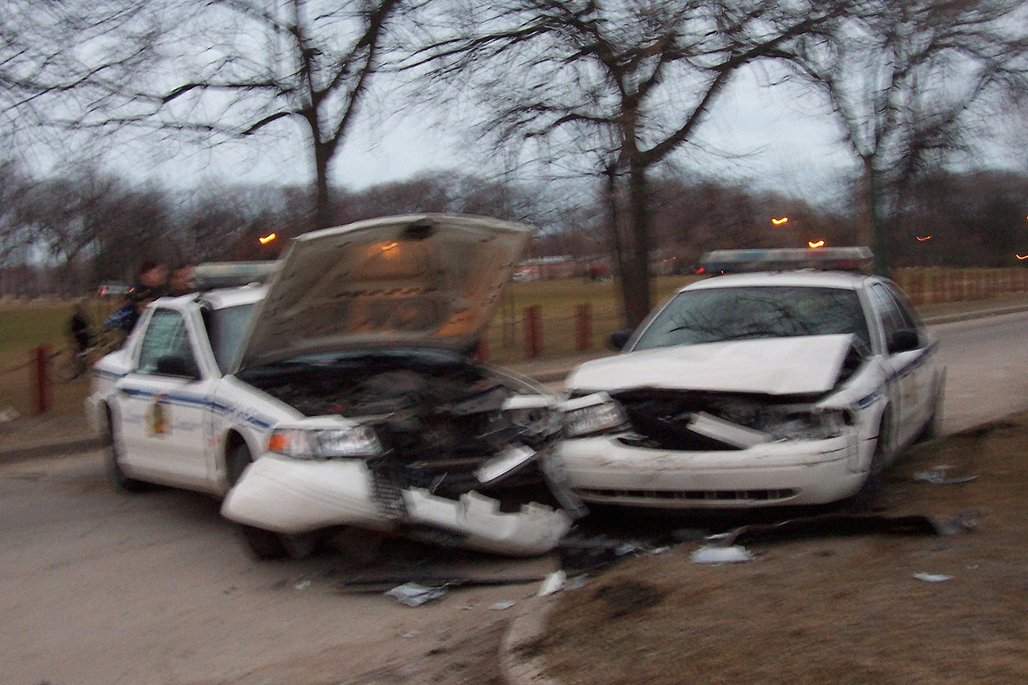
WHAT IF YOUR EMPLOYEE “CAN’T DRIVE 55” – “DO’S”
MAKE SURE THE ACCIDENT IS REPORTED AND INVESTIGATED
MAKE SURE THE EMPLOYEE AND WITNESSES COMPLETE INCIDENT REPORTS
FOLLOW POST-INCIDENT DRUG TESTING POLICIES
PROVIDE TORT CLAIM FORMS IF DAMAGE TO PRIVATE PROPERTY
ASSESS DISCIPLINE IF WARRANTED
This Photo by Unknown Author is licensed under CC BY-SA

Slide 16
WHAT IF YOUR EMPLOYEE “CAN’T DRIVE 55” – “DON’TS”
SWEEP THE INCIDENT UNDER THE RUG
DISCOURAGE LAW ENFORCEMENT INVOLVEMENT IF WARRANTED
HAVE THE EMPLOYEE USE THEIR PERSONAL HEALTH INSURANCE
FAIL TO FOLLOW THE WORKER’S COMPENSATION PROCESS
TALK TO THE MEDIA WITHOUT THE PIO
This Photo by Unknown Author is licensed under CC BY-SA

Slide 17
TESTING FOR “COCAINE” AND OTHER DRUGS – DO’S
UPDATE YOUR DRUG AND ALCOHOL POLICY
HAVE AN ATTORNEY REVIEW YOUR DRUG AND ALCOHOL POLICY
DISTRIBUTE THE POLICY AND TRAIN ON IT
USE PRE-EMPLOYMENT DRUG SCREENING
This Photo by Unknown Author is licensed under CC BY-NC-ND
This Photo by Unknown Author is licensed under CC BY-NC-ND

Slide 18
DON’T ALLOW EMPLOYEES TO “WANT A NEW DRUG”
CALL YOUR EMPLOYEE A DRUNK OR A DRUG ADDICT
ALLOW YOUR EMPLOYEE TO CONTINUE TO WORK IF THEY ARE IMPAIRED
DO RANDOM DRUG TESTING FOR ALL EMPLOYEES
FORGET TO TEST IN THE EVENT OF AN ACCIDENT
This Photo by Unknown Author is licensed under CC BY-NC-ND
This Photo by Unknown Author is licensed under CC BY-NC-ND

Slide 19
Workplace violence – avoiding the “eye of the tiger” – do’s
Take threats of violence seriously
Make use of law enforcement if necessary
Educate employees about the employee assistance program
Follow your policies and document incidents
This Photo by Unknown Author is licensed under CC BY-SA
This Photo by Unknown Author is licensed under CC BY-SA-NC

Slide 20
Workplace violence – avoiding the “eye of the tiger” – doN’Ts
IGNORE CREDIBLE THREATS
FAIL TO TRAIN YOUR EMPLOYEES ON ACTIVE SHOOTERS
LABEL YOUR EMPLOYEES
FAIL TO TRAIN AND ENFORCE PROPER WORKPLACE BEHAVIOR
This Photo by Unknown Author is licensed under CC BY-SA
This Photo by Unknown Author is licensed under CC BY-SA-NC

Slide 21
Collective bargaining from “the back of a cop car”
State statutes provide for collective bargaining of fire and police
If you have a cba – follow it!
Incorporate mou’s into cba’s
Remember parity with non-union workers
This Photo by Unknown Author is licensed under CC BY-SA

Slide 22
Collective bargaining from “the back of a cop car”
A non-probationary police officer who is a member of the pension system can only be terminated for cause
All paid firefighters (including the chief) can only be fired for cause
ALWAYS ENSURE DUE PROCES!!!
This Photo by Unknown Author is licensed under CC BY-SA

Slide 23
MAJOR CHALLENGES IN MUNICIPAL EMPLOYMENT
RECRUITMENT AND RETENTION
NEGATIVITY SURROUNDING LAW ENFORCEMENT AND OTHER CITY EMPLOYEES
PANDEMIC FATIGUE
COMPETITIVE WAGES
FLEXIBLE WORK SCHEDULES

Slide 24
BE “CHAMPIONS” -TOP 10 HITS TO AVOID LIABILITY IN EMPLOYMENT MATTERS
REGULARLY UPDATE YOUR EMPLOYEE HANDBOOK
TRAIN YOUR EMPLOYEES
CALL YOUR LAWYER
CONTINUALLY EDUCATE YOURSELF IN EMPLOYMENT ISSUES
ATTEND CLASSES – HAVE YOUR EMPLOYEES ATTEND CLASSES
PROVIDE DUE PROCESS

Slide 25
BE “CHAMPIONS” -TOP 10 HITS TO AVOID LIABILITY IN EMPLOYMENT MATTERS
DOCUMENT, DOCUMENT, DOCUMENT
REMEMBER THE DEGREES OF WORK
USE PROGRESSIVE DISCIPLINE
REVIEW YOUR CODE OF ORDINANCES
TRAIN YOUR EMPLOYEES

Slide 26
BETH ANNE CHILDS THE CHILDS LAW FIRM, PLLC 1015 SOUTH DETROIT AVENUE TULSA, OK 74120 (918) 521-3092

