Slide 1
Profitable Relationships: Overcoming Fear and Building Confidence
Andrew L. Urich, J.D.
Department Head, Business Administration
Eastin Chair for Career Readiness
Spears School of Business
Oklahoma State University
405.744.8619
aurich@okstate.edu
www.andrewurich.com

Slide 2
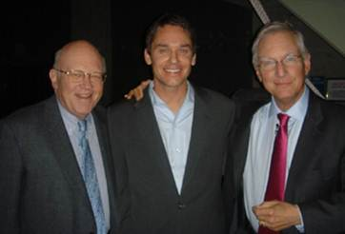
Management Network

Slide 3
In the Club

Slide 4
How to Learn Something You Don’t Know

Slide 5
Beliefs vs. Truth Beliefs/ideas are applied to get what you want
Good Grades = Success
A belief is a thought in your mind that you like having.
The thought either makes you
feel good or
makes you feel not scared or
gives you an excuse for being the way you are.

Slide 6
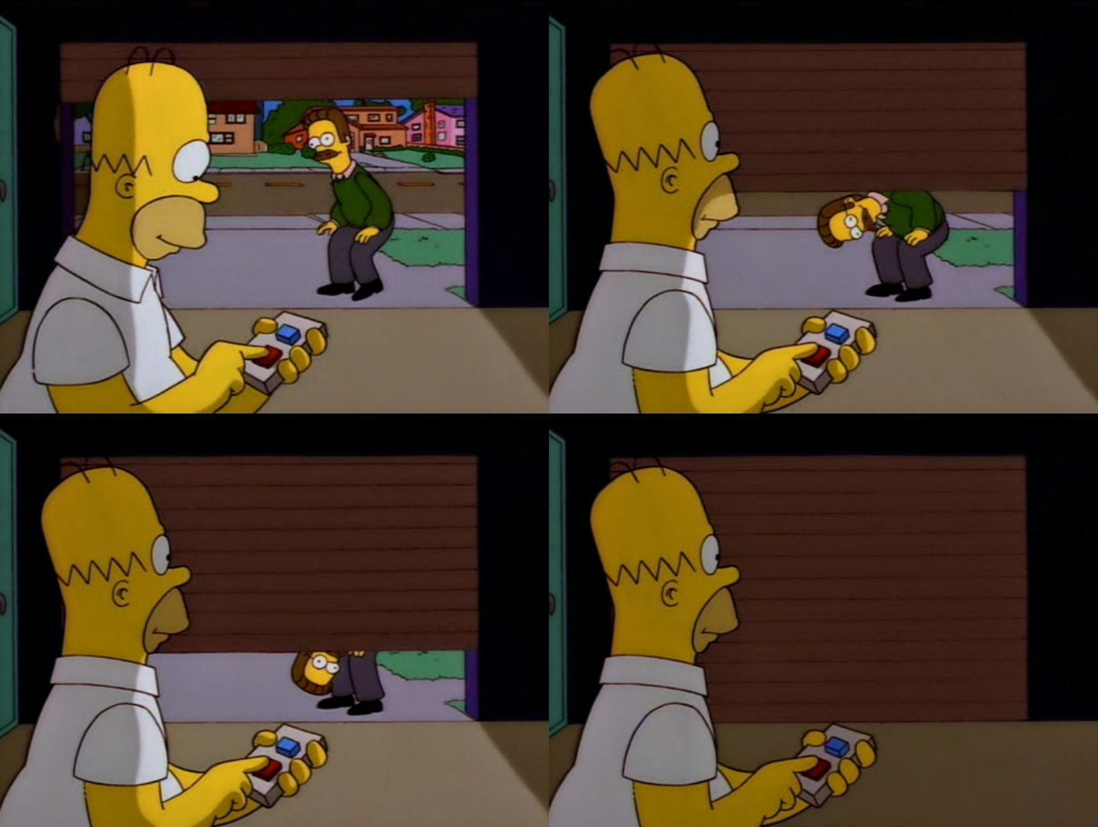
Simon Sinek: “When we are closed to ideas, what we hear is criticism. When we are open to criticism, what we get is advice.”

Slide 7
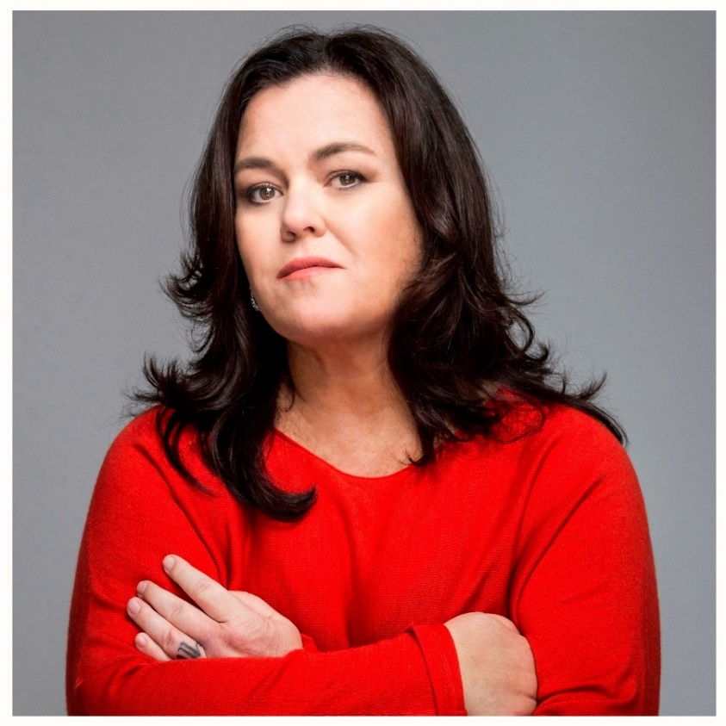
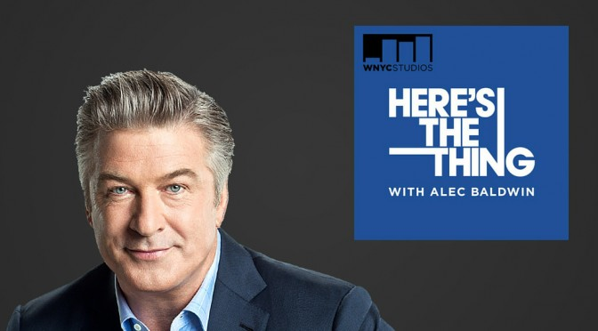
Growth & Success Rosie O’Donnell

Slide 8
1) Be True to Yourself
Notes:
Rosie wrote the skits for her high school variety show for years, senior year a parent invited her to his comedy club

Slide 9
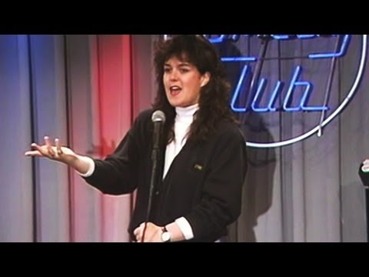
Fail and fail often
2) Confidence, failure & motivation go hand in hand

Slide 10
3) Be the kind of person—People want to know
Notes:
Shirley Hemphill really liked Rosie and insisted that Rosie open for her every night and act as the MC

Slide 11
Who you know gets you in the door
4) Connect and find opportunities to stay connected
Notes:
Rosie was nice to everyone so everyone recommended her to clubs and she never had to audition

Slide 12
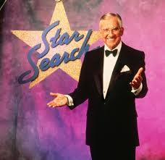
5) Put yourself in a position for good things to happen

Slide 13
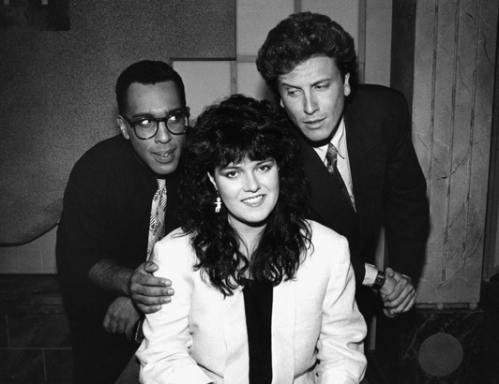
Conversational vs. Presentational
6) Add to your talent stack
VH1 in 23 Million homes

Slide 14
Send a thank you note
7) Show appreciation
Notes:
Got this gig by sending a thank you note.
VH1 in 23 million homes– something good has to happen.
Develop a skill she needs conversation instead of presentation

Slide 15
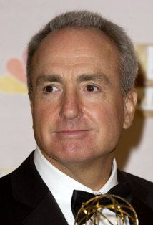
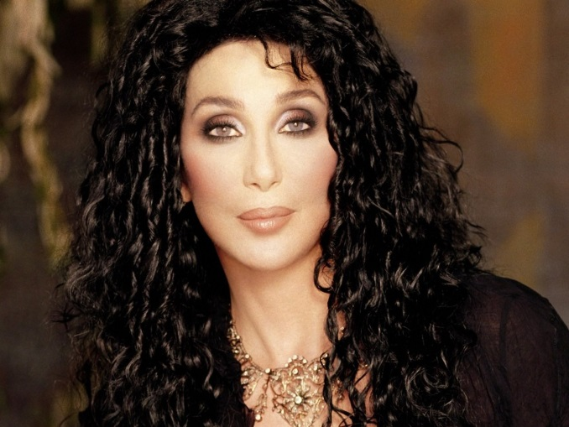
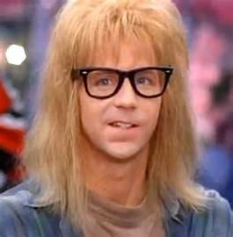
Appreciate the people who support you
Notes:
Loren Michaels, Cher, Brandon Tartikoff go to see Dana Carvey trying out for SNL. Waitresses refuse to3 drop the check until Rosie does her act.

Slide 16
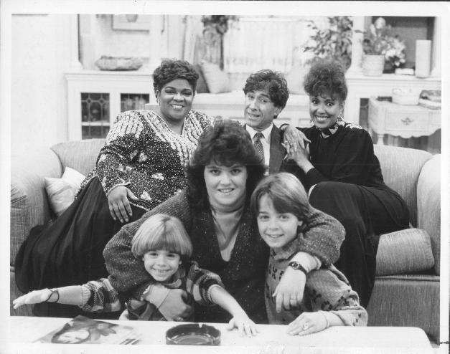

Slide 17
8) Always be composed

Slide 18
9) Focus on helping others (Giver)

Slide 19
Spider-man

Slide 20
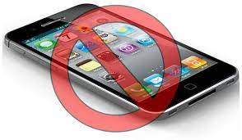
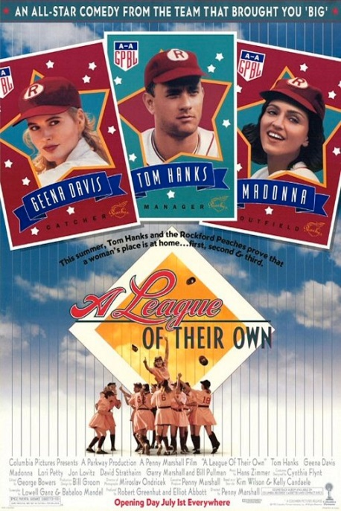
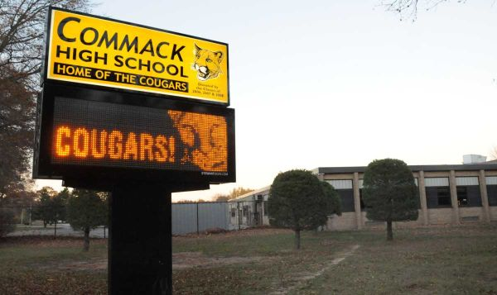
Everything you do, everything you learn and everyone you meet can come back to help you.
10) Be engaged and do interesting things
High school softball

Slide 21
Conscious effort to hit it off with people Research people before you meet them Find something in common
11) Being interested– is more important than being interesting
Notes:
Watched Madonna’s movie the night before Rosie met Madonna. Found things in common– mothers had same name and dies while they were young.

Slide 22
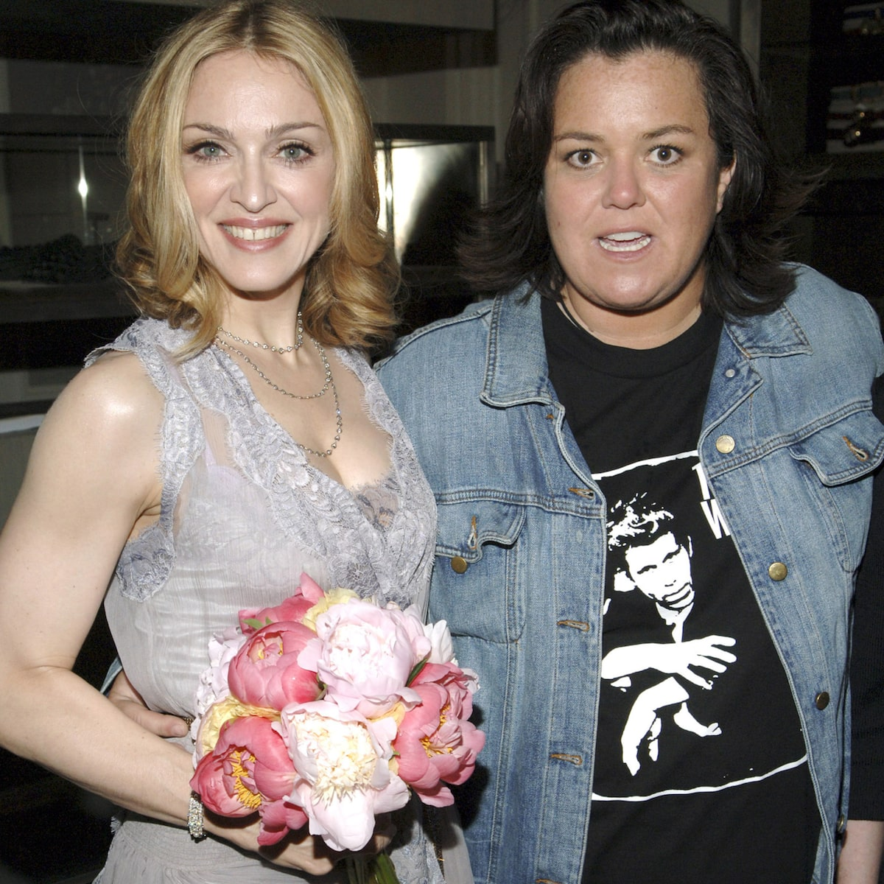
Conscious effort to hit it off with people Research people before you meet them Find something in common
12) Form strong genuine connections
Notes:
Watched Madonna’s movie the night before Rosie met Madonna. Found things in common– mothers had same name and dies while they were young.

Slide 23
Softball legacy

Slide 24
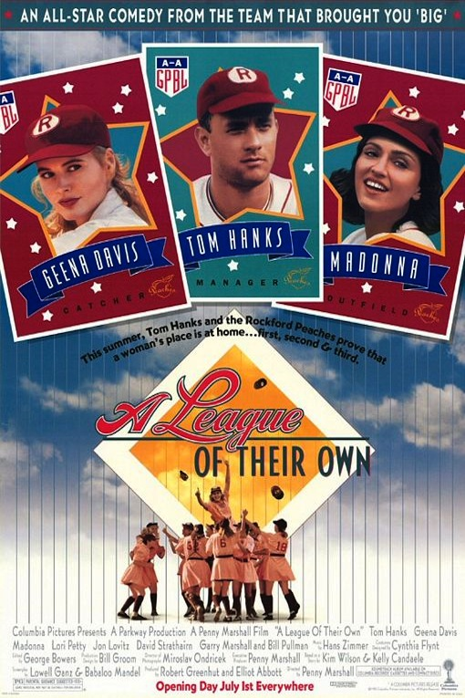
People will recommend you
13) Impress people with great work
Notes:
Nora Ephron’s child thought Rosie was cool.

Slide 25
Friendly and self-deprecating Be nice to everyone Be real and genuine “The Queen of Nice”
14) Establish your GENUINE reputation/brand

Slide 26
Investing in Relationships Is Like Investing Your Money
15) Relationships create value
It is painful and boring at the beginning
$1,800/year $5/day
5 years: $11,000
10 years: $29,000
20 years: $103,000
30 years: $296,000
40 years: $800,000
50 years: $2 million

Slide 27
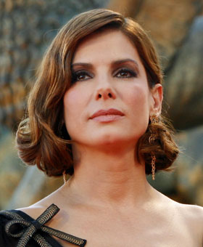
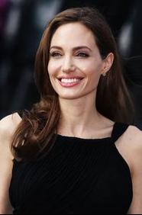
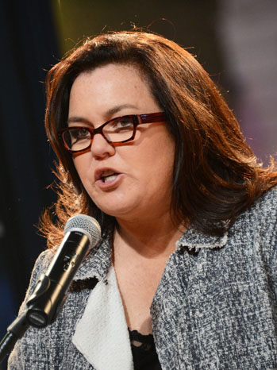
$100 million celebrities

Slide 28
People Skills: Three Keys to Success
Genuine
Focus on needs of others
Put yourself in a position for good things to happen

Slide 29
Genuine
1) Be True to Yourself
4) Connect and find opportunities to stay connected
10) Be engaged and do interesting things
12) Form strong genuine connections
14) Establish your GENUINE reputation/brand

Slide 30
Focus on needs of others
6) Add to your talent stack
7) Show appreciation
9) Focus on helping others (Giver)
11) Being interested– is more important than being interesting
13) Impress people with great work

Slide 31
Put yourself in a position for good things to happen
2) Confidence, failure & motivation go hand in hand
3) Be the kind of person—People want to know
5) Put yourself in a position for good things to happen
8) Always be composed
15) Relationships create value

Slide 32
Overcoming Fear & Building Confidence

Slide 33
Resistance vs. Growth & Success
“Resistance is any act that prefers
immediate gratification to long-term
growth, health or integrity.”
“Resistance is internal.”
“Resistance plays to keep.
It comes to kill.”
“Resistance is fueled by fear. Master our fear and we conquer
resistance.”

Slide 34
How to Fight Resistance

Slide 35
How to Fight Resistance

Slide 36
How to Fight Resistance
Action isn’t just the result of motivation – it is also the cause of it.

Slide 37
The Mountain

Slide 38
Motivation
Drive: The Surprising Truth About What Motivates Us
-Daniel Pink
The best predictor of success: GRIT
Defined as “perseverance and passion for long-term goals.”

Slide 39
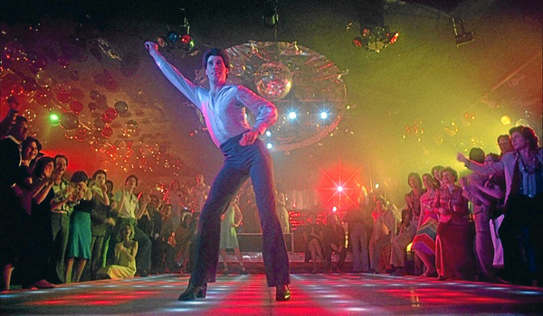
Failure at the Disco

Slide 41
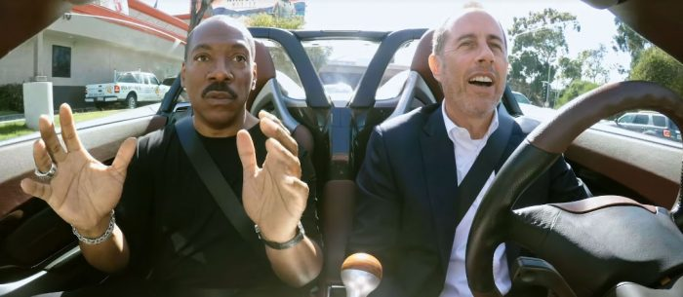
You Were Fearless

Slide 42
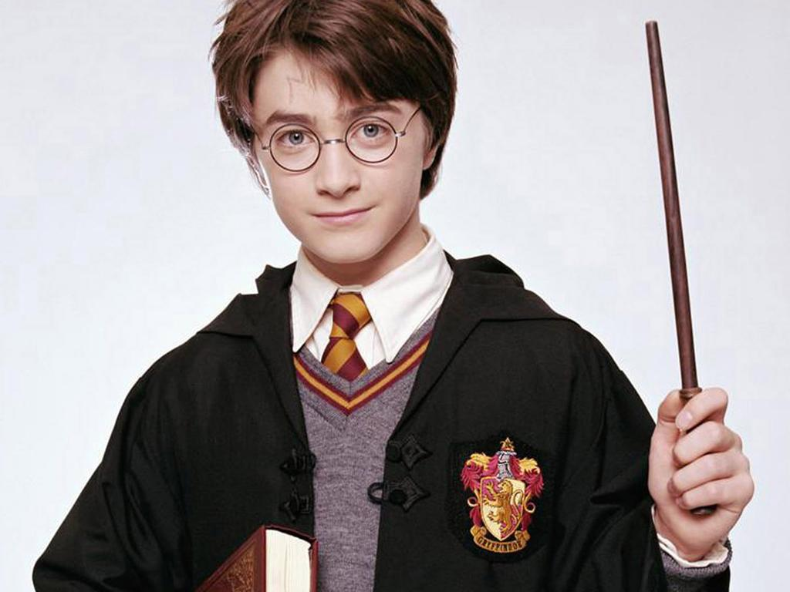
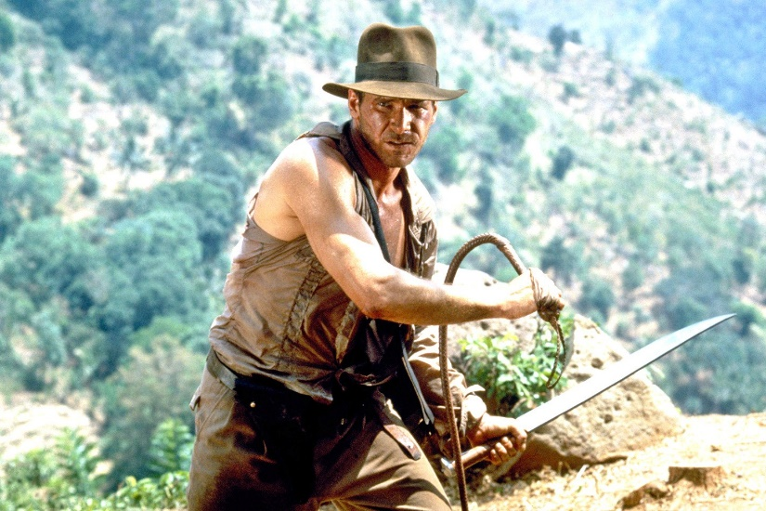
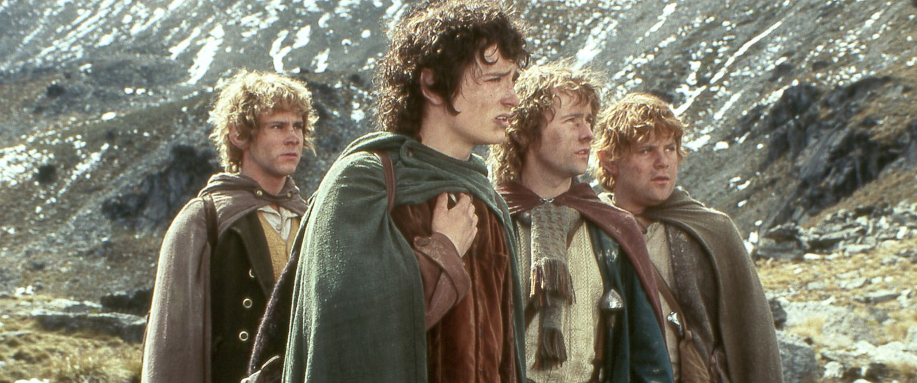
The Purpose of Life Grow & Succeed

Slide 44
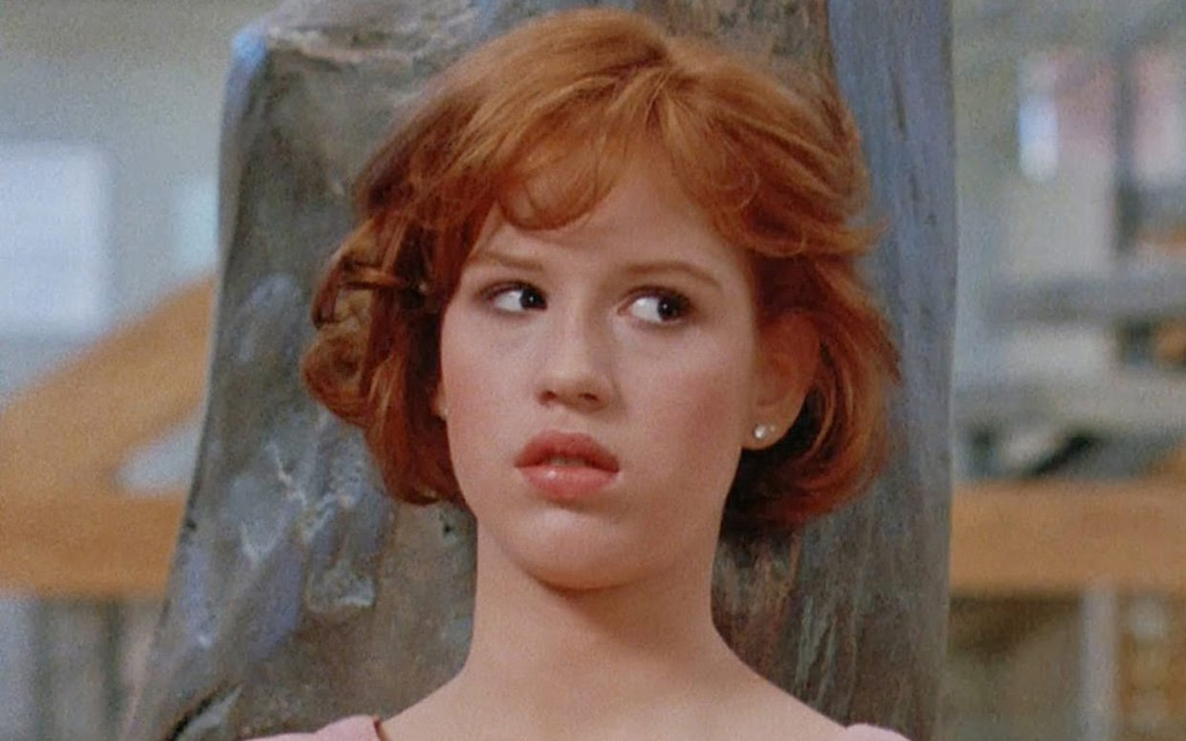
Courage

Slide 45
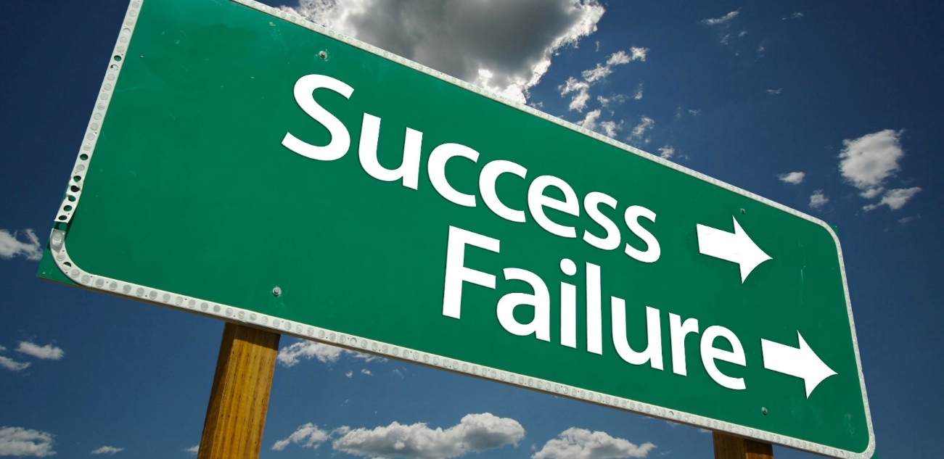
Failure: The more you try the sooner you get lucky
Reading first law case in college
Interviewing for accounting job in college
Smacking
Where do you see yourself in 5 years?
Invested student loan in college
Law school Moot Court project

Slide 46
Takers, Matchers & Givers Give and Take, Adam Grant
Taker
Belief: competitive dog eat dog world
Actions: self-promote, seek credit for work
Focus: self-interested
Goal: Get more than you give-- Win

Slide 47
Takers, Matchers & Givers Give and Take, Adam Grant
Matcher
Belief: fairness
Actions: expect reciprocity
Focus: fairness
Goal: exchange favors

Slide 48
Takers, Matchers & Givers Give and Take, Adam Grant
Giver
Belief: sharing
Actions: helpful
Focus: needs of others
Goal: close relationships

Slide 49
Takers, Matchers & Givers Give and Take, Adam Grant
Who’s at the bottom?
Givers
Too caring
Too trusting
Sacrifice
Too worried about needs of others
Stats
14% less $
Twice as likely to be victim of crime
22% less powerful and dominant

Slide 50
Takers, Matchers & Givers Give and Take, Adam Grant
Who’s at the top?
Givers
Strategic in giving
Others around you succeed
People are rooting for you
When Takers win
Someone else loses
People gunning for the taker
Few supporters

Slide 51
Givers who win! Give and Take, Adam Grant
Concerns for Other Interests
LOW HIGH
LOW
HIGH
Apathetic:
Selfish:
Takers
Selfless:
Self-sacrificing Givers
(too trusting, too empathetic and too timid)
Other focused:
Successful Givers
(Willing to give more than you receive)
Concern for self-interest

Slide 52
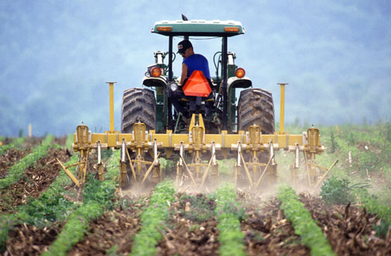
Strategic Giver
Networking is like farming

Slide 53
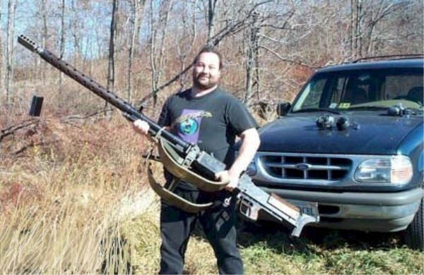
Takers hunt

Slide 54
Thank you!
Facebook.com/ProfessorUrich
aurich@okstate.edu
www.andrewurich.com

