Slide 1
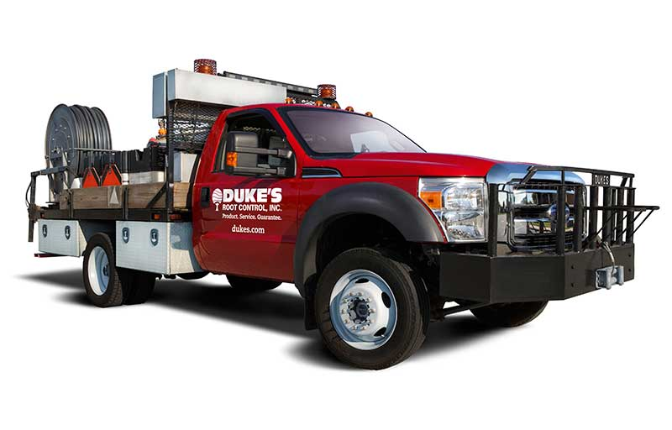
Gastonia, NC – Precision I/I Microdetection Study
Product. Service. Guarantee.

Slide 2
A Smart, Scalable, &
Cents-a-able Strategy
for a healthy sewer system starts with Triage

Slide 3
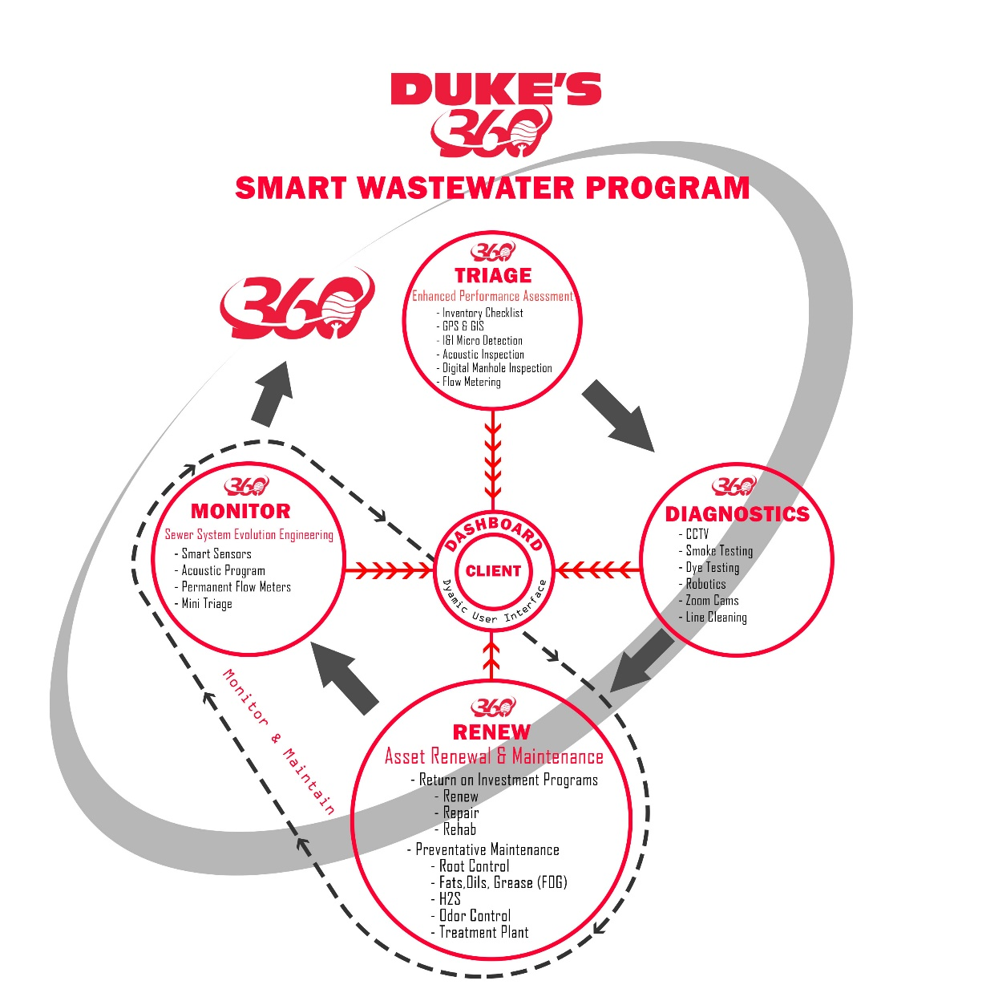
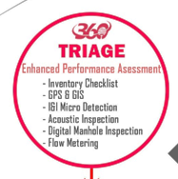
Gastonia, NC – Precision I/I Microdetection Study
Product. Service. Guarantee.

Slide 4
PRECISION I&I MICRODETECTION – PINPOINT I&I
Purpose: Pinpoint the contributors of inflow and infiltration within adjacent manholes utilizing iTracker sensors and our auto analytics platform to determine RDII
iTracking vs Flow Monitoring
Flow monitoring measures flow;
iTracking pinpoints the sources of
I&I within a collection system to
efficiently use your SSES dollars to
find the 80% I&I within 20% of your
system that is leading to excess
treatment costs and overflows
Gastonia, NC – Precision I/I Microdetection Study
Product. Service. Guarantee.

Slide 5
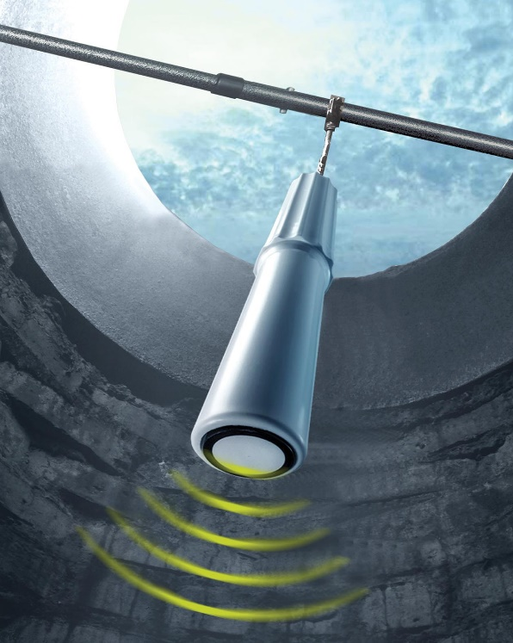
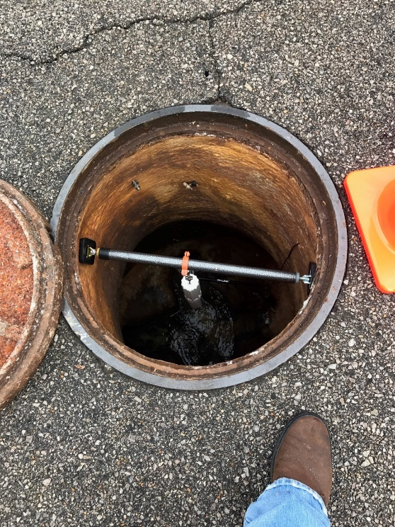
PRECISION I&I MICRODETECTION– PINPOINT I&I
iTrackers® monitor and record changes in wastewater volume as small as 1/10”
Deployed upstream of regional flow meters to record levels from 0-100% of the pipe ID.
Bridges the gap between flow meters and inspection CCTV camera equipment
Gastonia, NC – Precision I/I Microdetection Study
Product. Service. Guarantee.

Slide 6
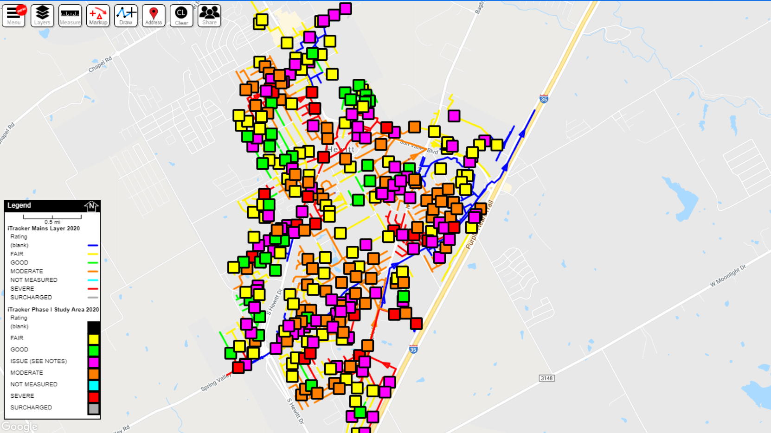
PRECISION I&I MICRODETECTION– PINPOINT I&I
Keys to success:
Rapid deployment of units
Measures RDII in same rain event
Rain gauges deployed to create local climate
30-60 day studies
Installations approximately every 800LF
Linking units to eachother to pinpoint I&I sources
Gastonia, NC – Precision I/I Microdetection Study
Product. Service. Guarantee.

Slide 7
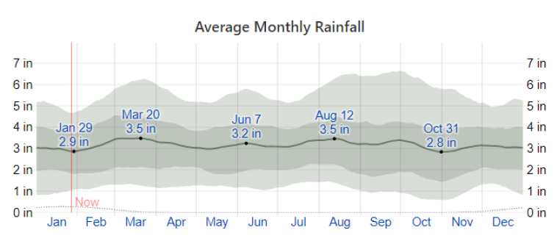
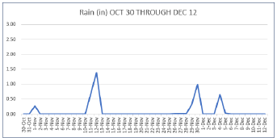
RAIN DATA
Weather Station: Gastonia, NC Adult Recreation Center Rain Gauge
Rainfall total for study period
October 30-31: 0 inches
November 1-30: 3.74 inches
December 1-12: 0.68 inches
Largest rain event
Repeatable response

Slide 8
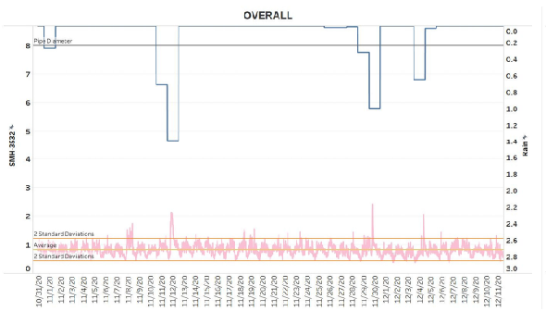
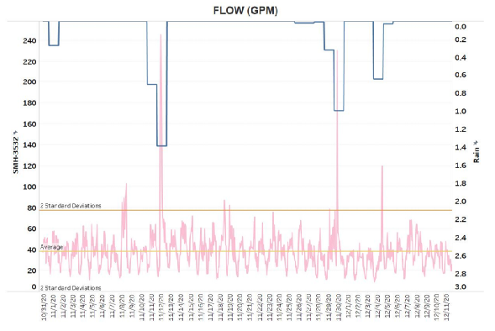
CHARTS / GRAPHS
HYDRAGRAPHS / FLOW APPROXIMATIONS – observed variation due to rain events – (MODerate/SEVERE)

Slide 9
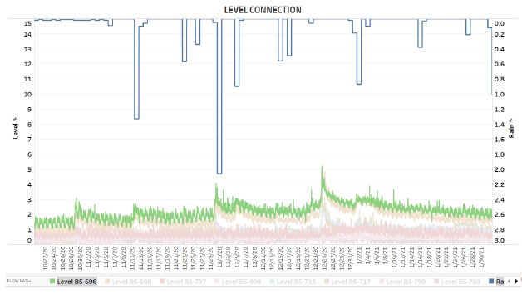
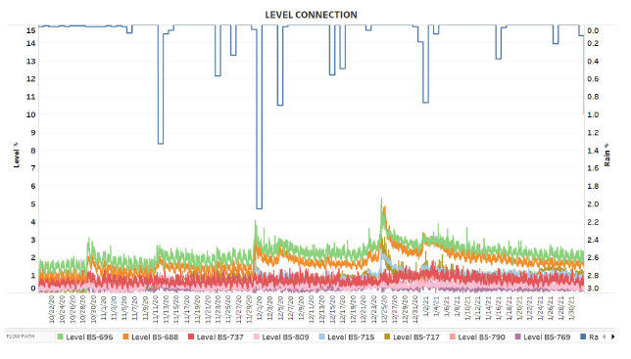
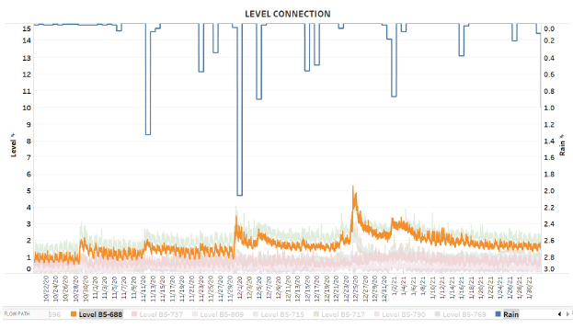
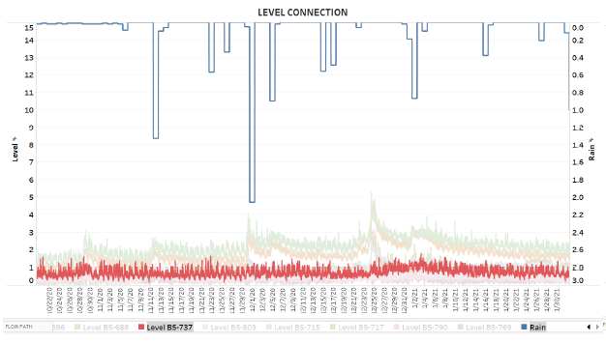
CHARTS / GRAPHS
Level connection analysis

Slide 10
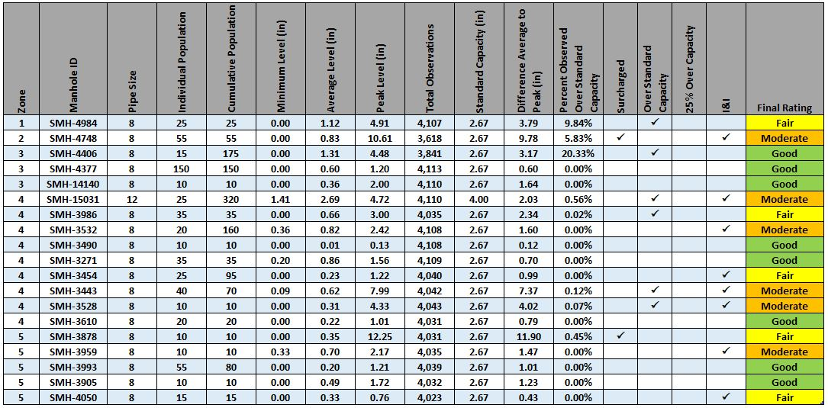
POPULATION TABLE

Slide 11
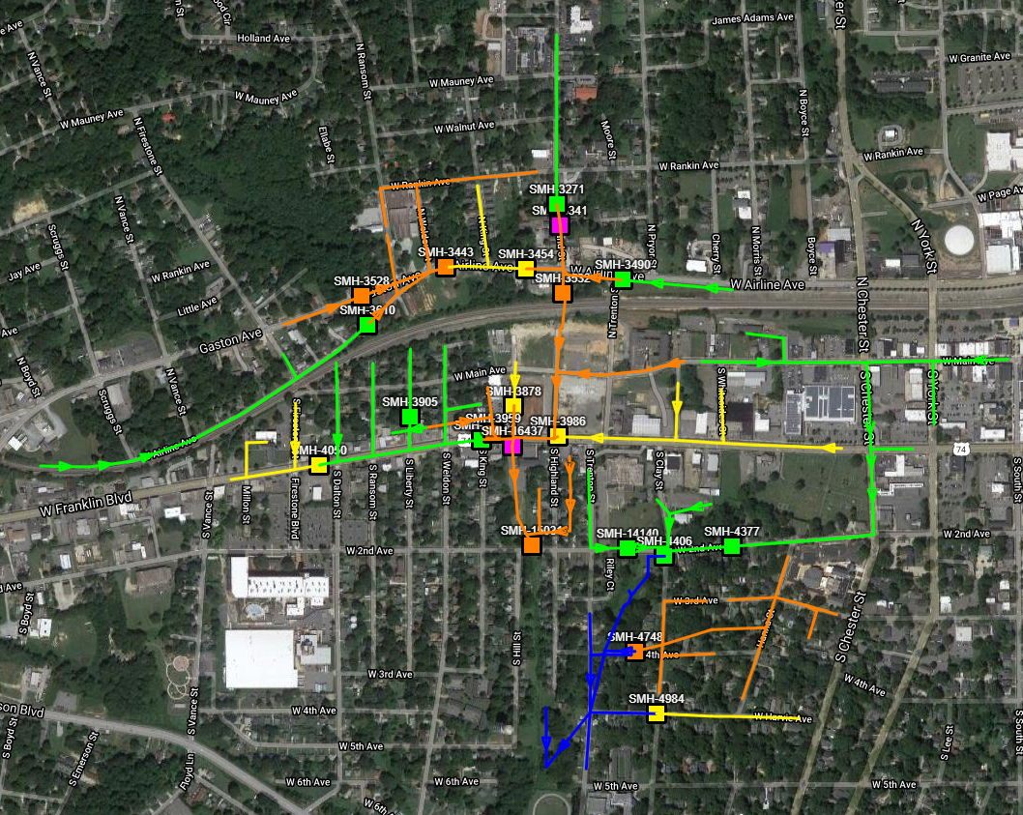
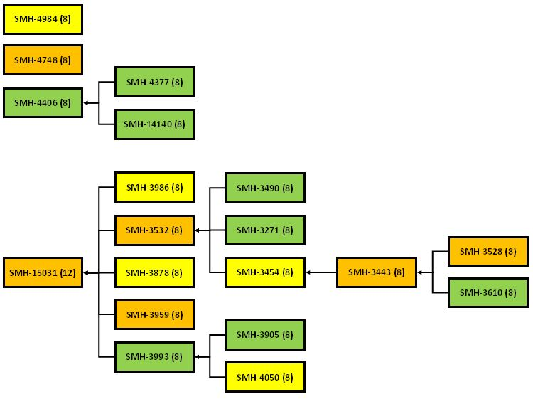
FINAL MAP

Slide 12
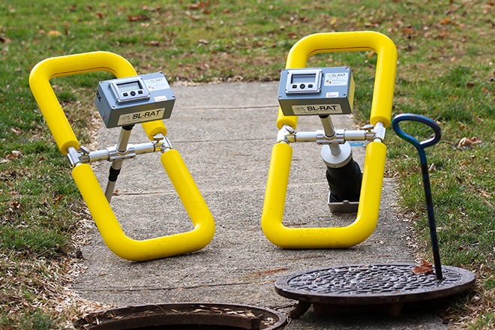
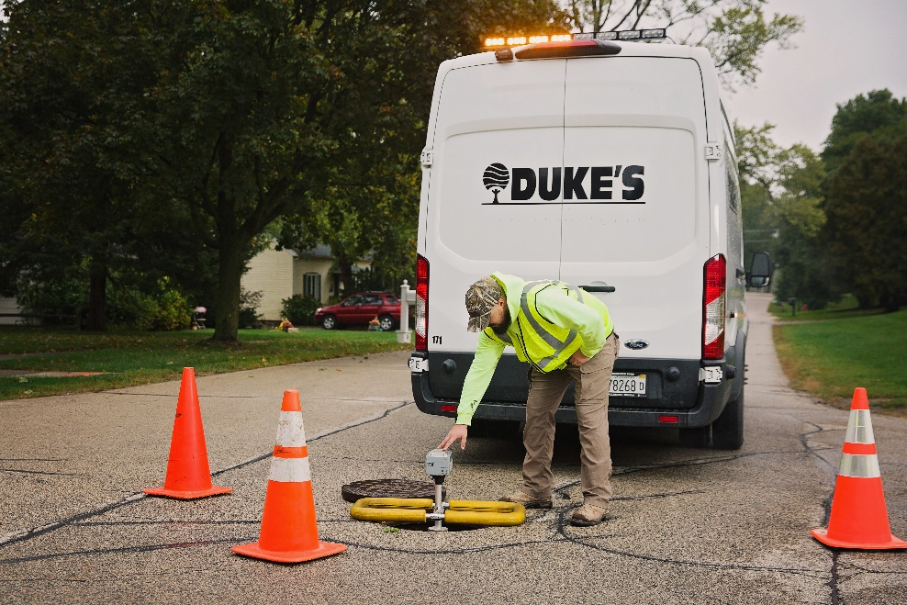
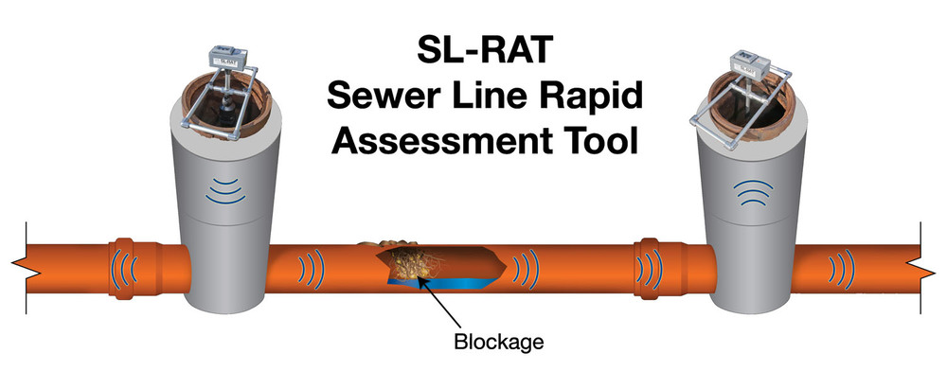
ACOUSTIC INSPECTION

Slide 13
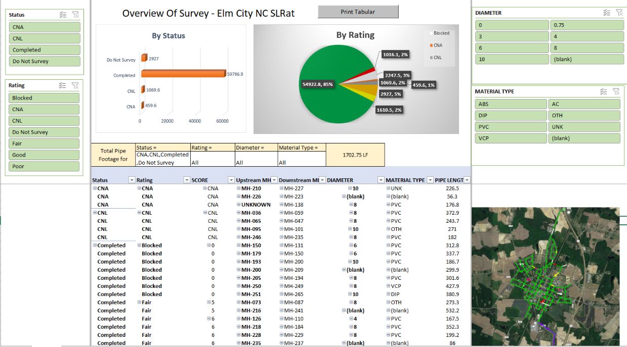
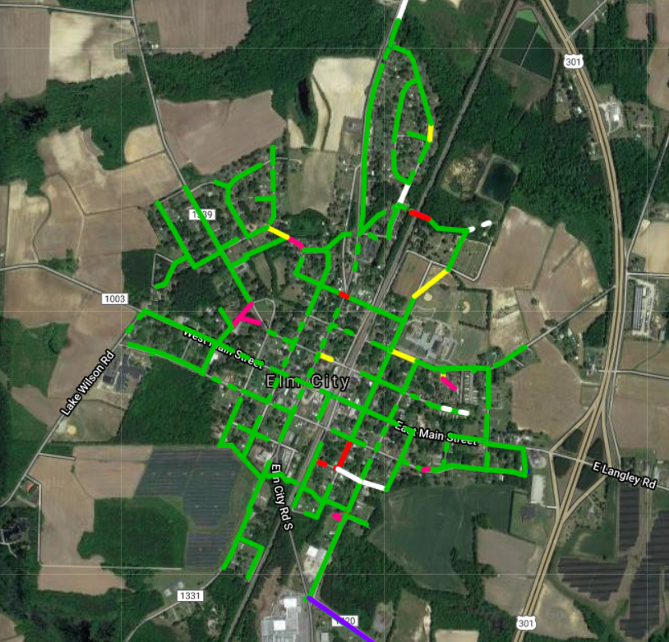
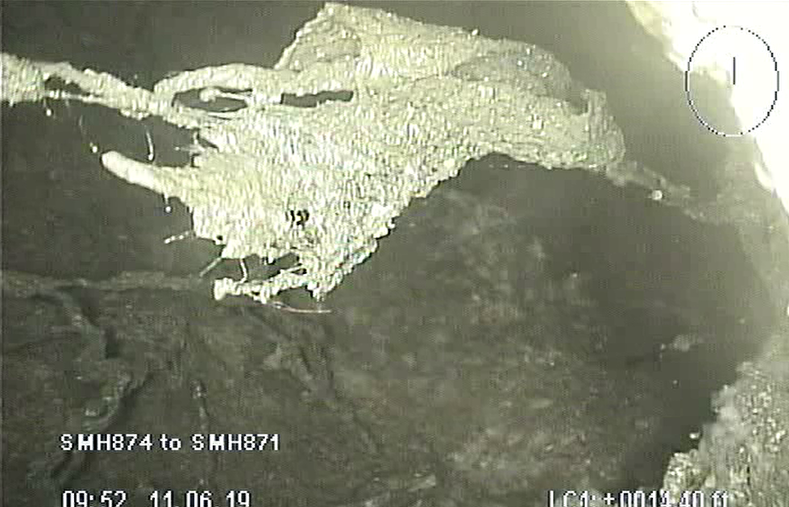
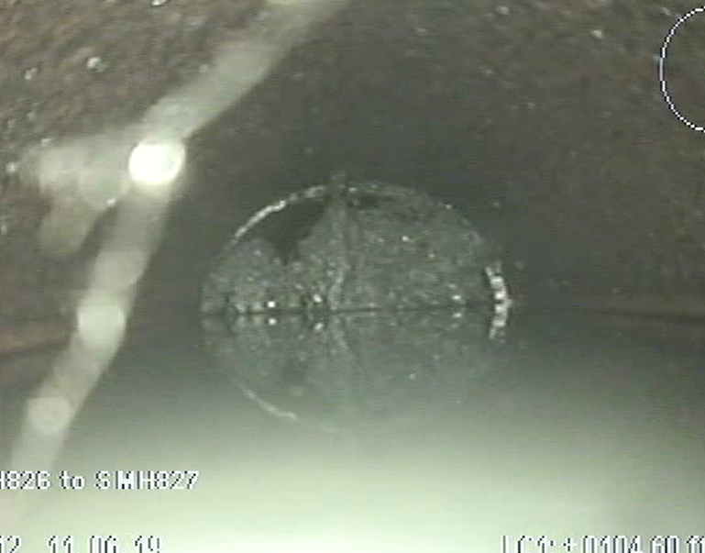
ACOUSTIC INSPECTION
Collapsed pipe
Root Blockage

Slide 14
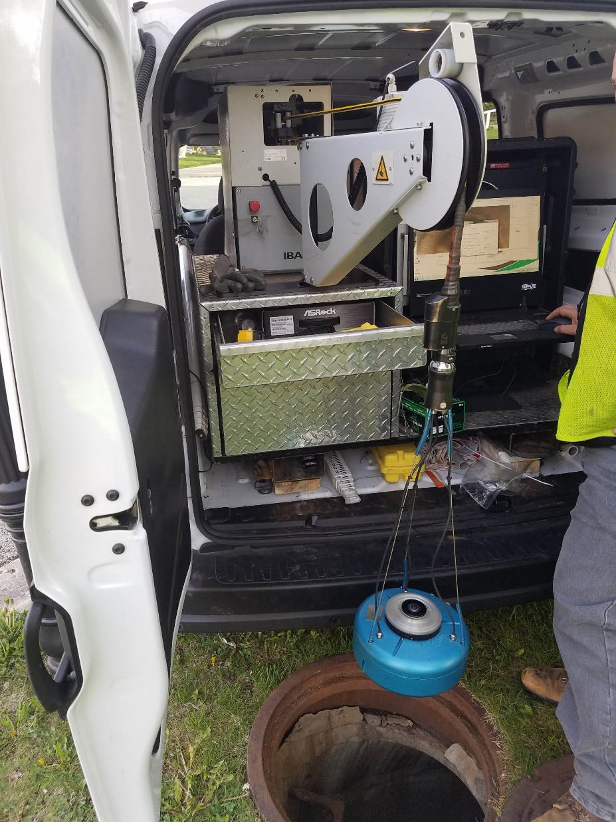
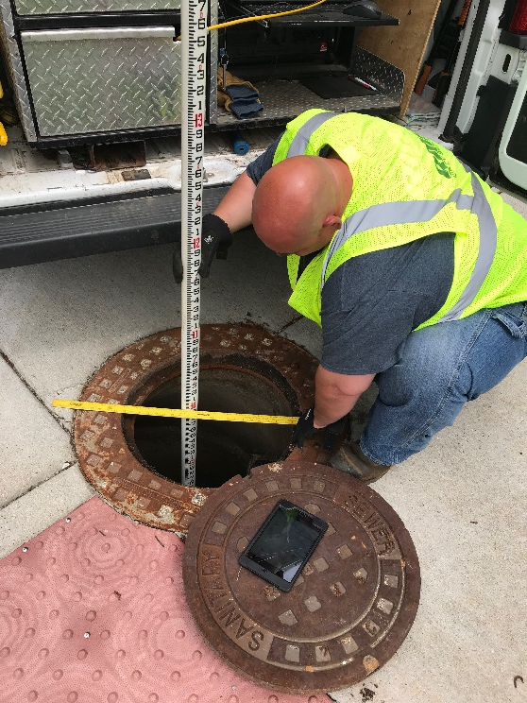
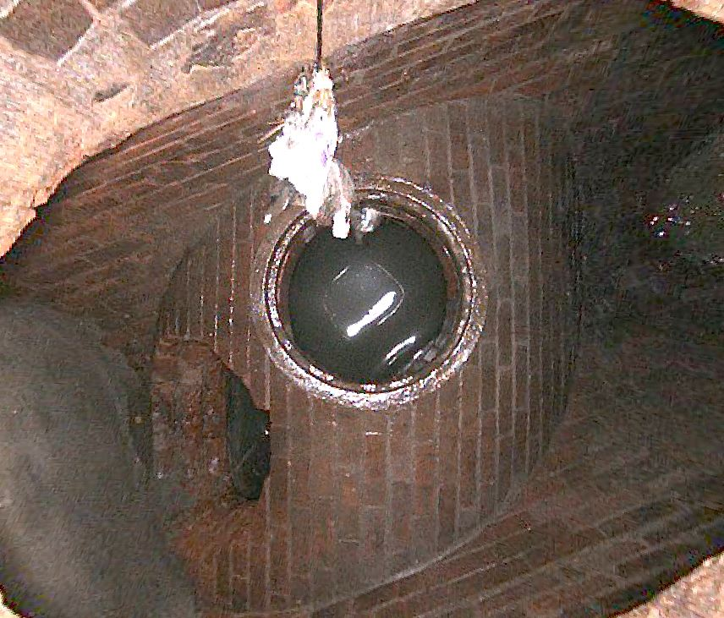
MANHOLE INSPECTIONS

Slide 15
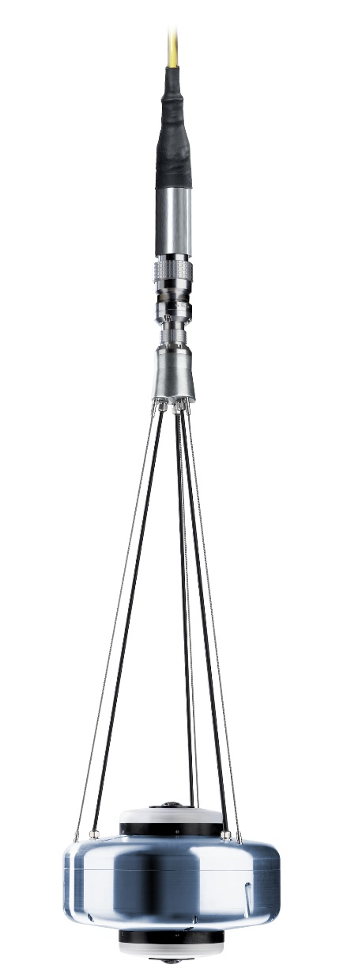
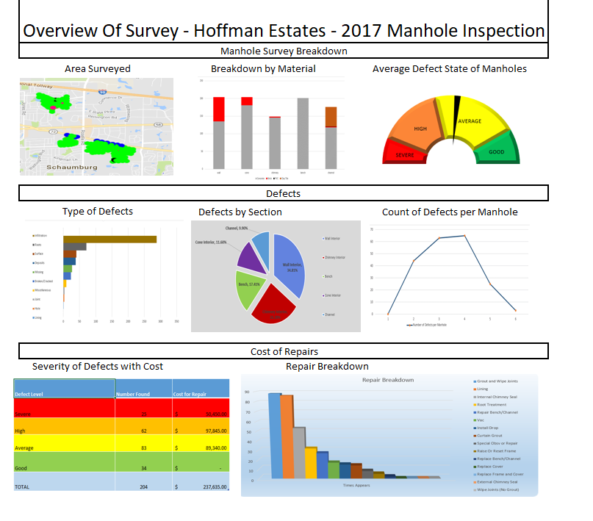
MANHOLE INSPECTIONS

Slide 16
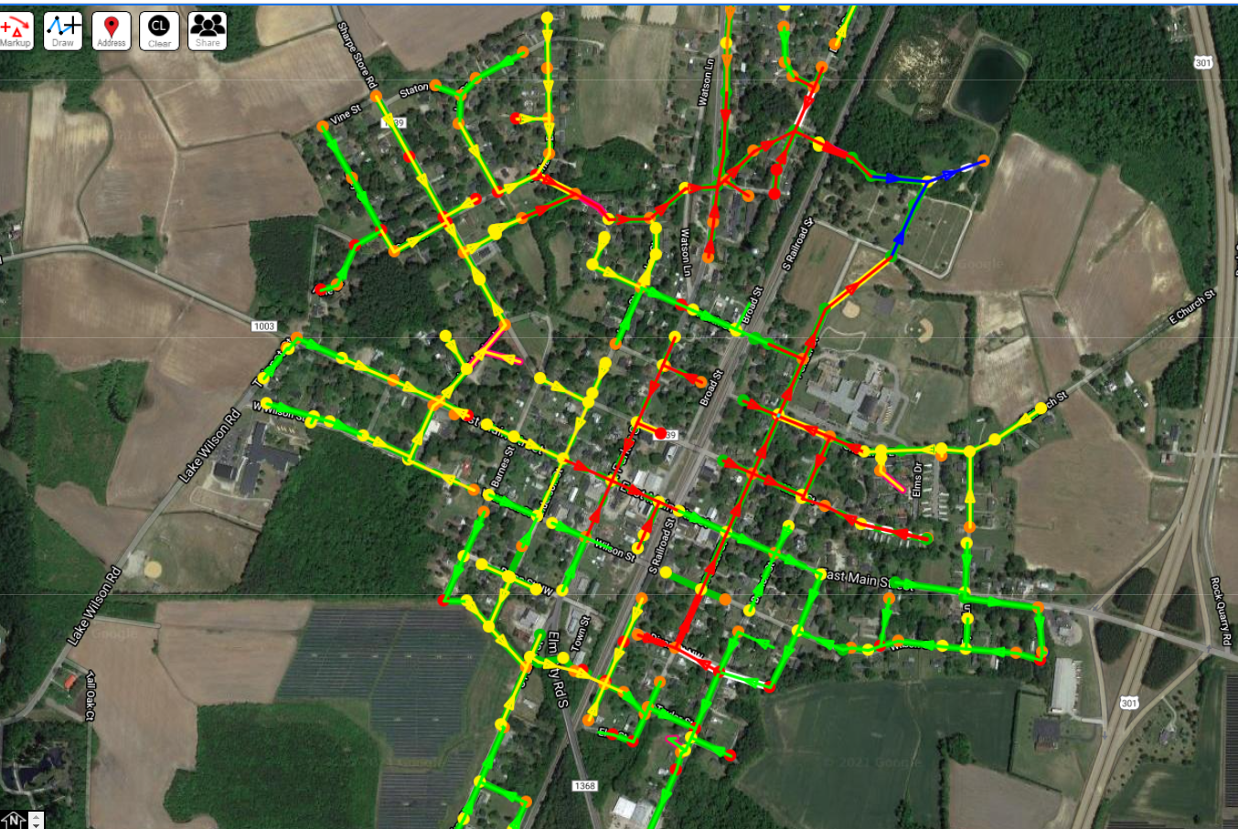
Overlaying the results

Slide 17
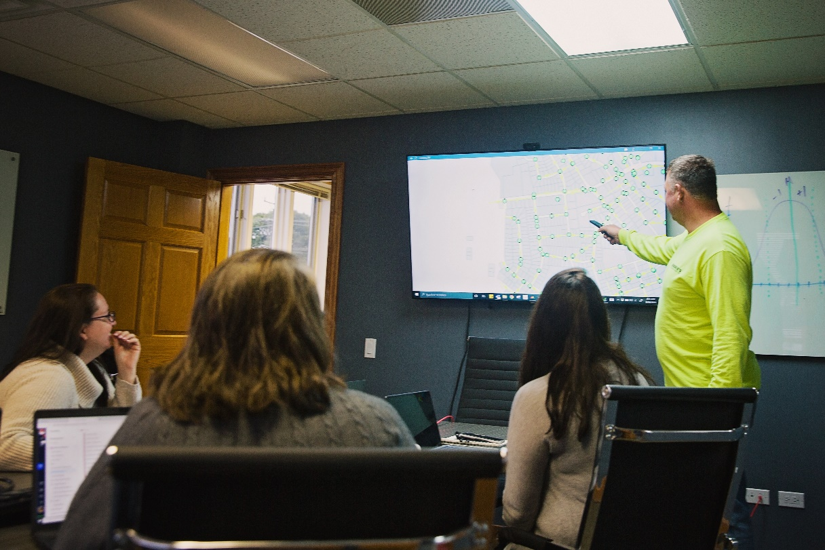
analytics
Deliverables You Can Use
Geodatabase with all reports/pictures attached
Easy to understand reports
Industry accepted formats and calculators
Executive Write Ups and Conclusions

Slide 18
Product. Service. Guarantee.

